Slide 1
MS-DOS demoscene 2021 - software rendering, sizecoding and modern approach to retro-demomaking
Artem Vasilev :: wbcbz7 @ Demodulation 2021

Slide 2
why? what?
while most of other oldskool platforms live through surge of retrocomputer interest, PC is no an exception
did you ever wanted to make something for oldskool PC but were afraid of?
we’ll be focused on these topics:
PC/DOS scene origins and historic periods
hardware overview – from original IBM machines to late-90 midskool stuff
in-depth breakdown – x86, VGA and DOS/BIOS
“ms-dos scener 101” guide – development tools and environment
…and maybe even some livecoding (if we have enough free time :)

Slide 3
why dos?
MS-DOS is, scene-wise, quite a curious platform…
being initially associated with “boring office typewriters”, in the 90s quickly made it’s own way on throwing competitors out of market with raw CPU power and open architecture
on the eve of millennium, while almost every PC software making it’s way on Windows, Linux or other OSes, DOS still stayed as appealing platform for multimedia audiovisual enthusiasts
eventually moved onto Windows and DirectX/OpenGL, of course
close-to-metal experience, software rendering being the most natural way
very friendly environment for extremely tiny sized stuff
… it’s fun :)

Slide 4
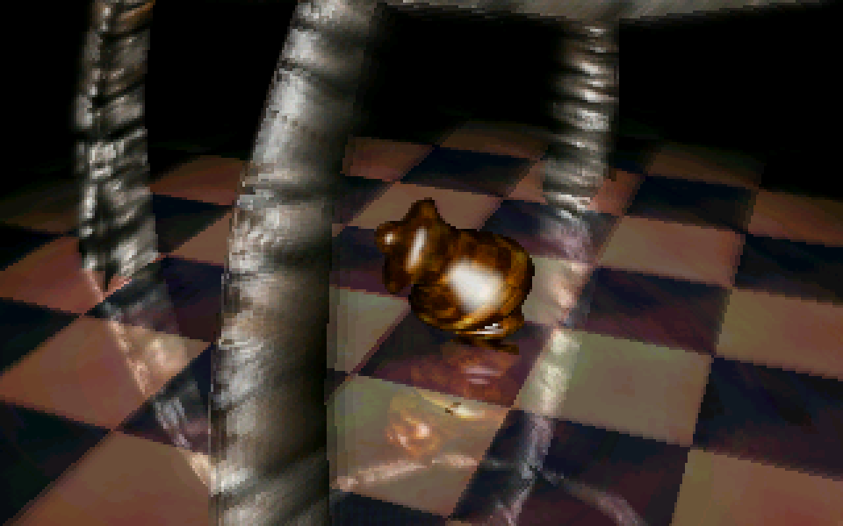
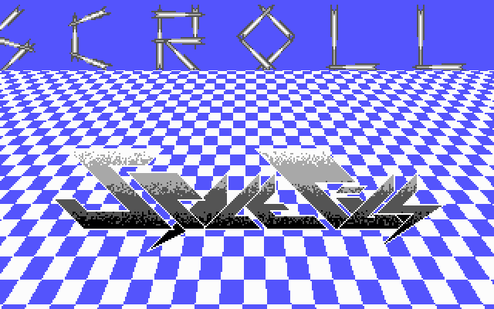
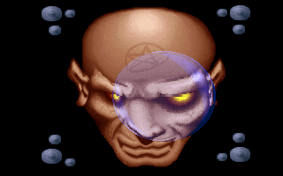

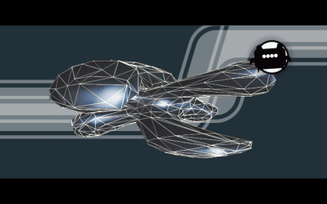
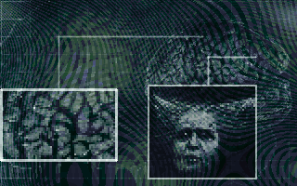
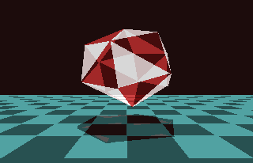

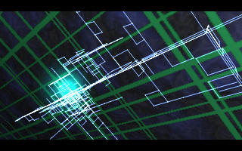
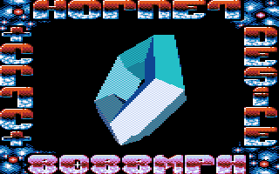
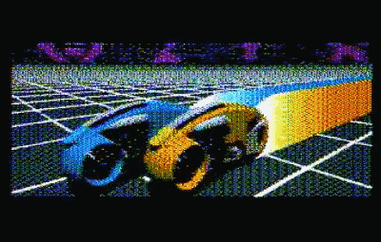

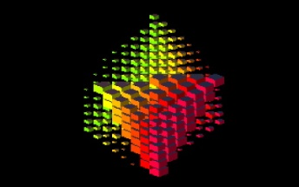
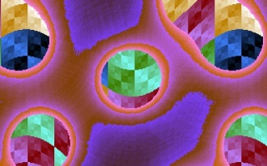
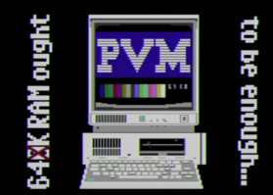
ms-dos demoscene :: distinctive periods
the birth (1990 – 1992)
286-386, EGA/VGA, Covox/SB
the golden age (1993 – 1996)
486, VGA, GUS
the transfiguration (1997 – 1999)
Pentium, SVGA, GUS/SB16
Original IBM PC machines
sizecoding

Slide 5
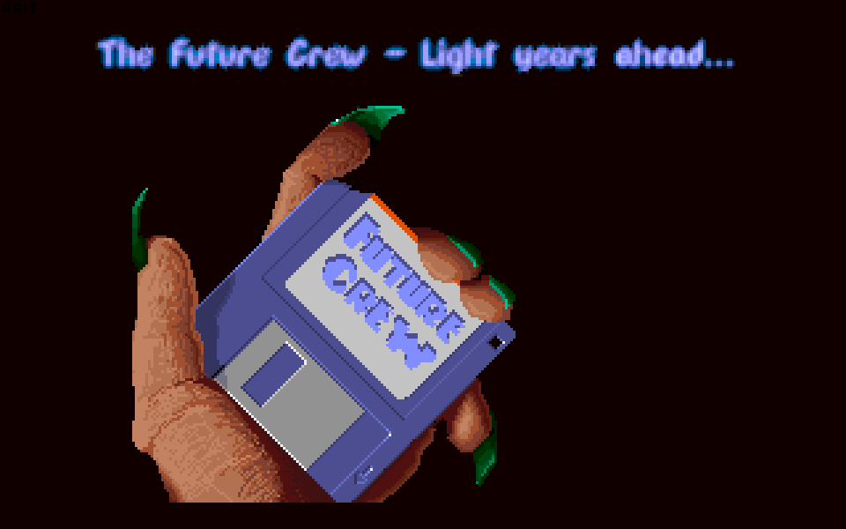
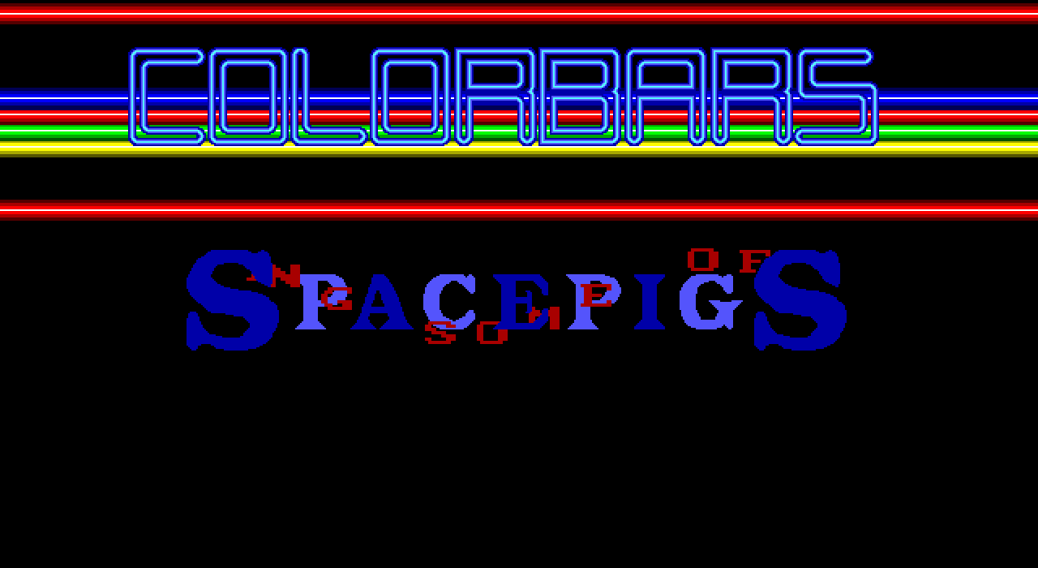
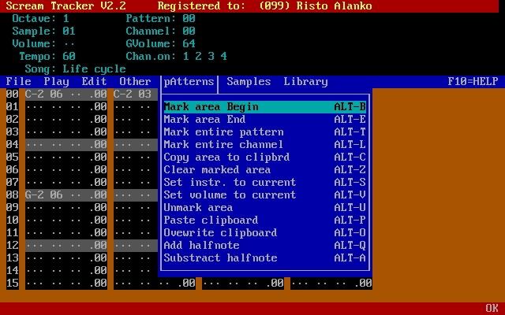
ms-dos demoscene :: the birth
inspired by both cracktros and Amiga demoscene, started from simple EGA/VGA experiments with ripped samples and 4 channel mods.
Slideshow by Future Crew (1990) – first ever production with 4-channel MOD music
Megademo by The Space Pigs (1990) – the first big scene production, and it runs on EGA!
Scream Tracker 2 by Future Crew (1990-1992) – marking the start of PC trackers era

Slide 6
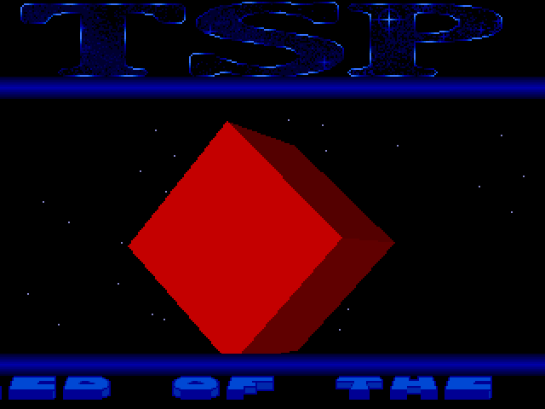

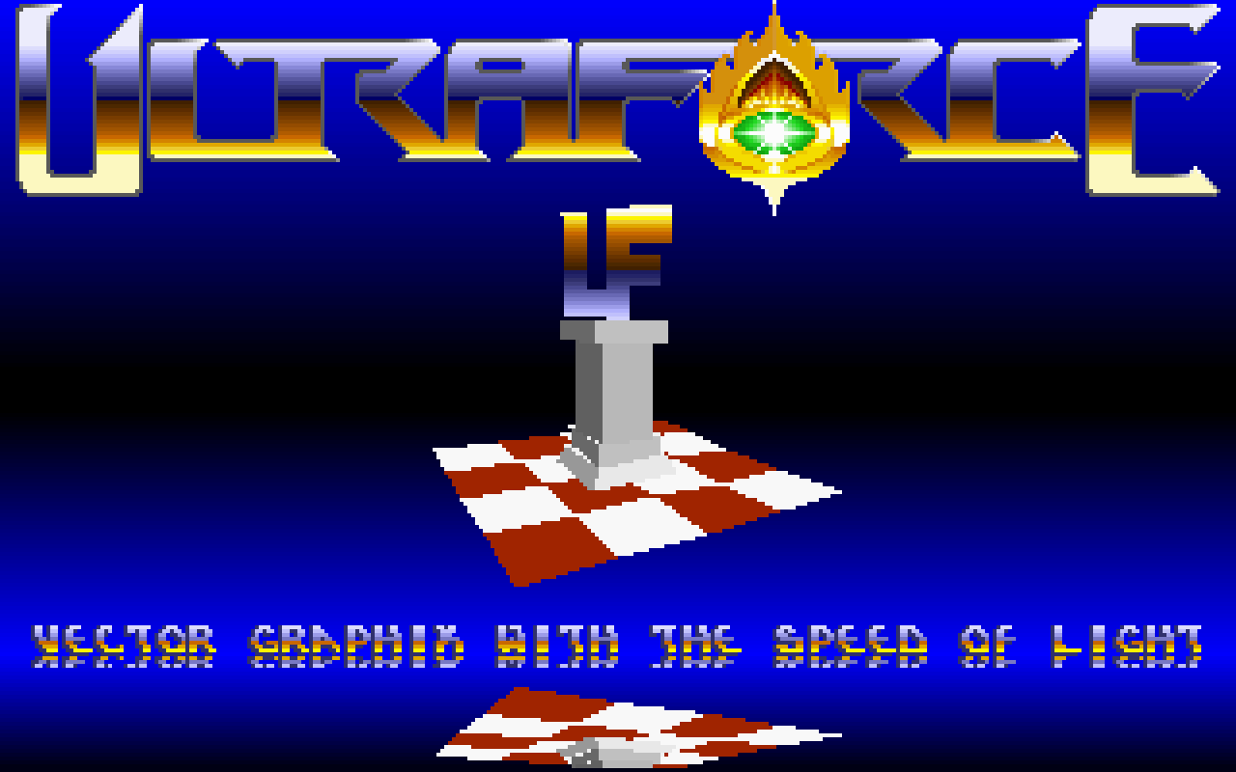
ms-dos demoscene :: the birth:: 1991
…slowly drifting towards vector worlds ….
Vicky by The Space Pigs (1991)
Cronologia by Cascada (1991)
VectorDemo by Ultraforce (1991)

Slide 7
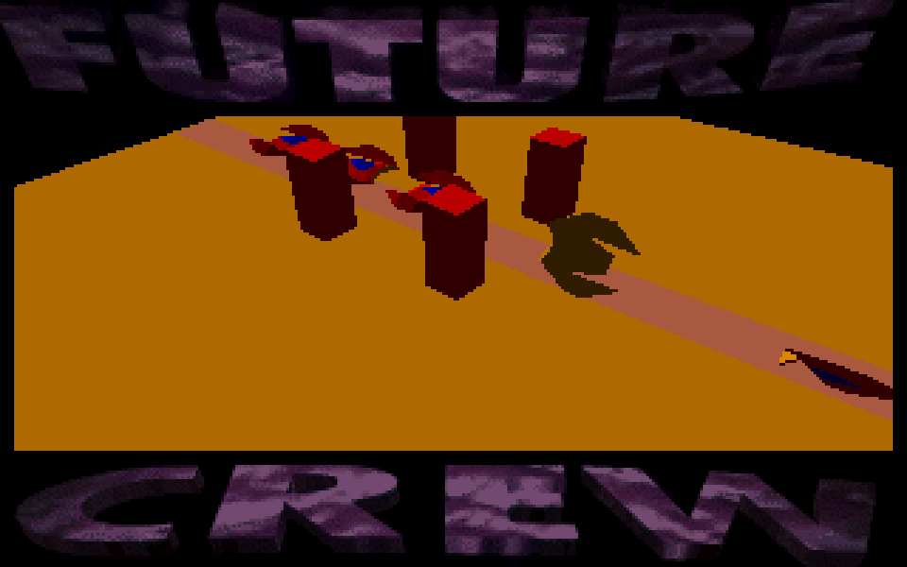
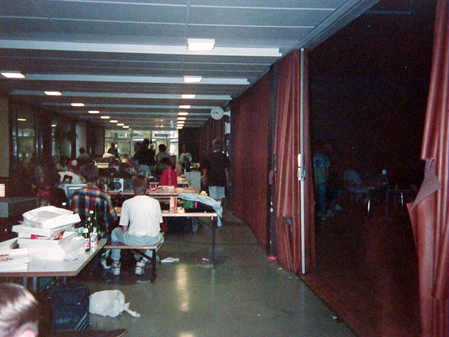
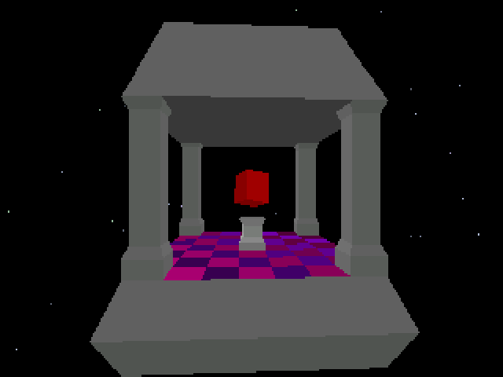
ms-dos demoscene :: the birth :: 1992
eventually reaching Amiga level of complexity with rapid performance growth
Unreal by Future Crew (1992)
Assembly 1992 – the first major demoparty with PC compos
Amnesia by Renaissance (1992)

Slide 8

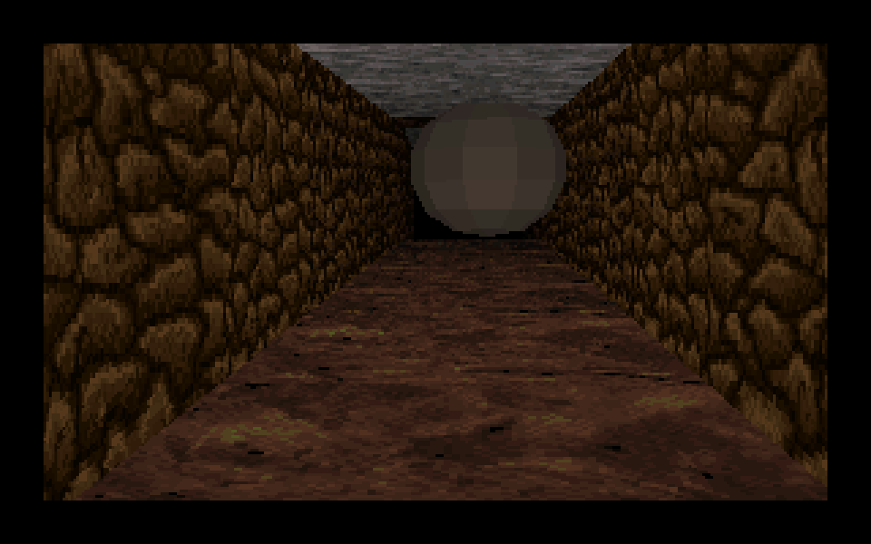
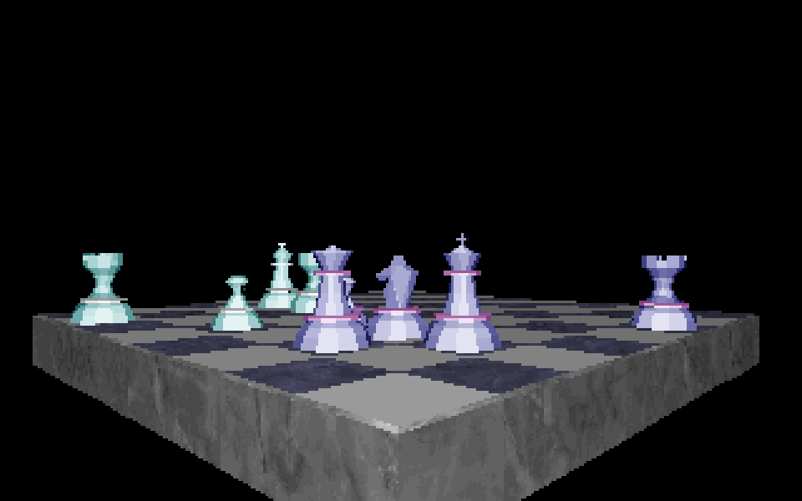
ms-dos demoscene :: the birth :: 1993
... driving beyond four channel MODs with new trackers and hardware like GUS …
Second Reality by Future Crew (1993)
Untitled by Dust (1993)
Crystal Dream II by Triton (1993)

Slide 9

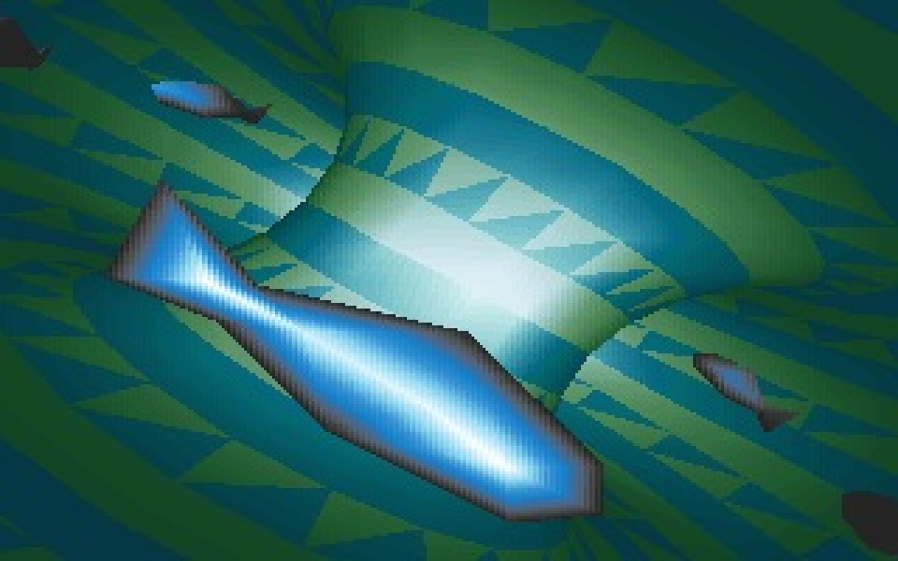
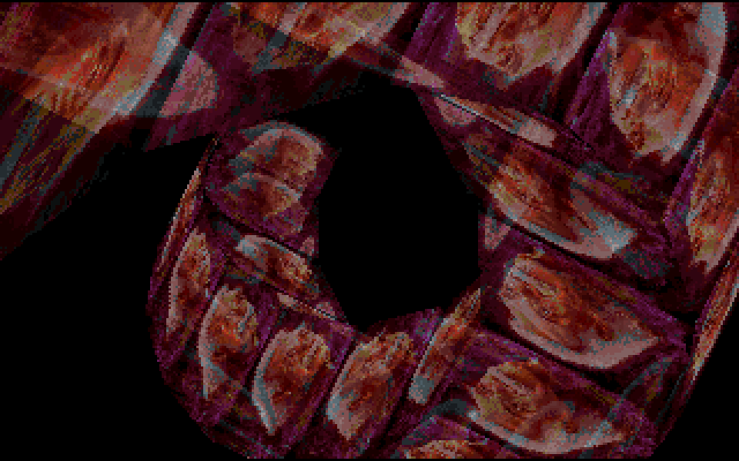
ms-dos demoscene :: the golden age:: 1994
... quickly catching up with and beyond the new Amiga AGA capabilities …
Verses by Electromotive Force (1994)
Cyboman 2 by Complex (1994)
No! by NoooN (1994)

Slide 10
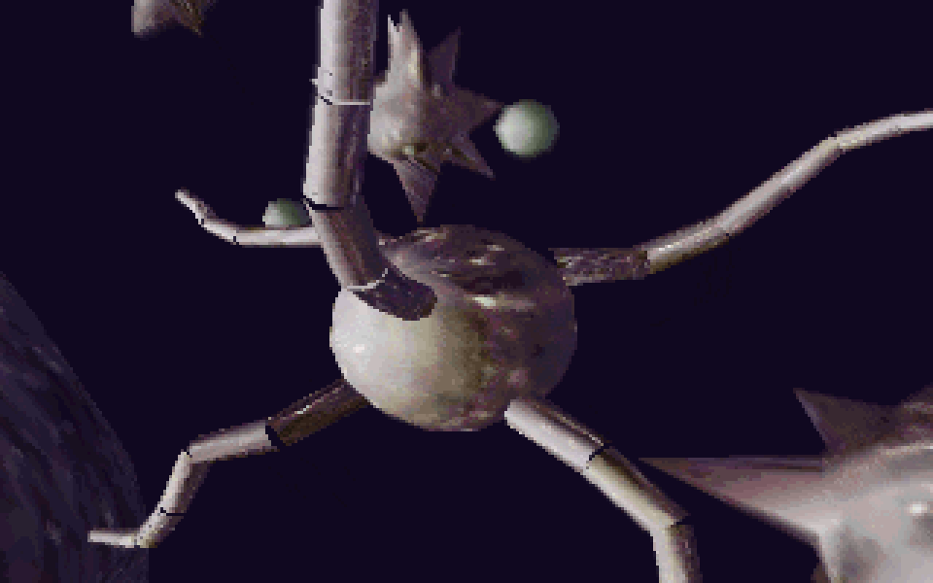
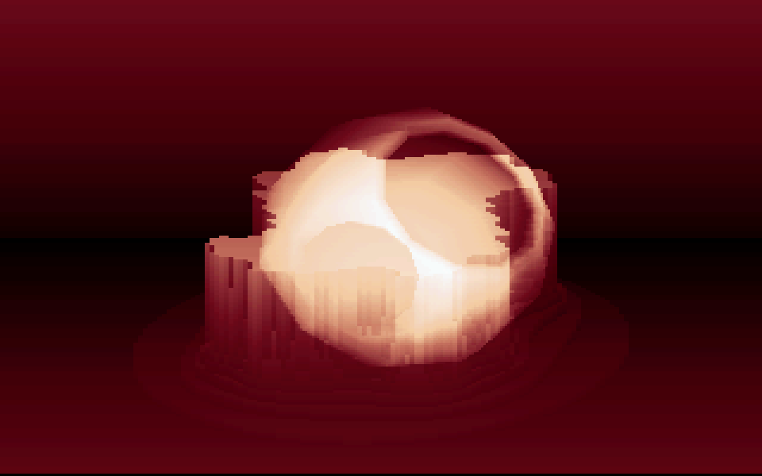
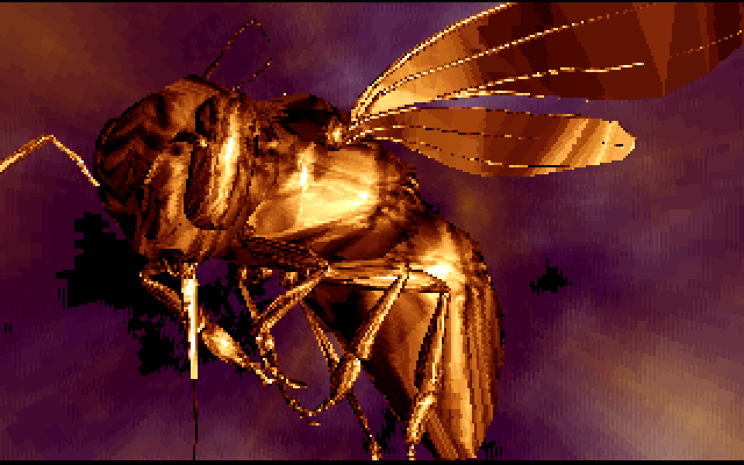
ms-dos demoscene :: the golden age:: 1995
... expanding to high resolution and phong shaded duck.3ds land …
Caero by Electromotive Force (1995)
Drift by Wild Light (1995)
Stars: Wonders of the World by NoooN (1995)

Slide 11
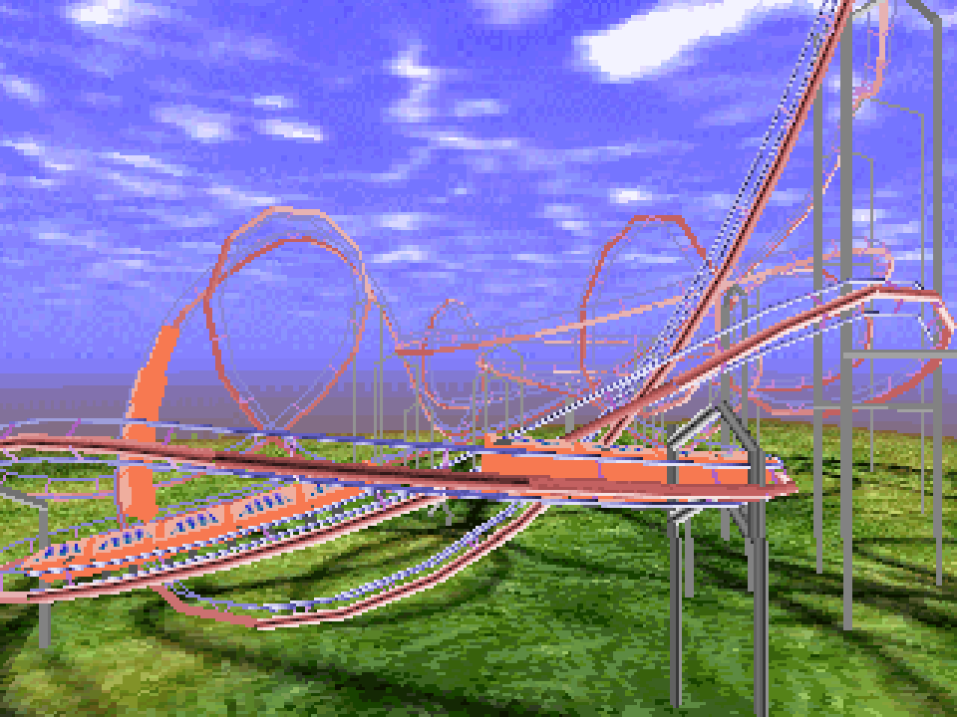

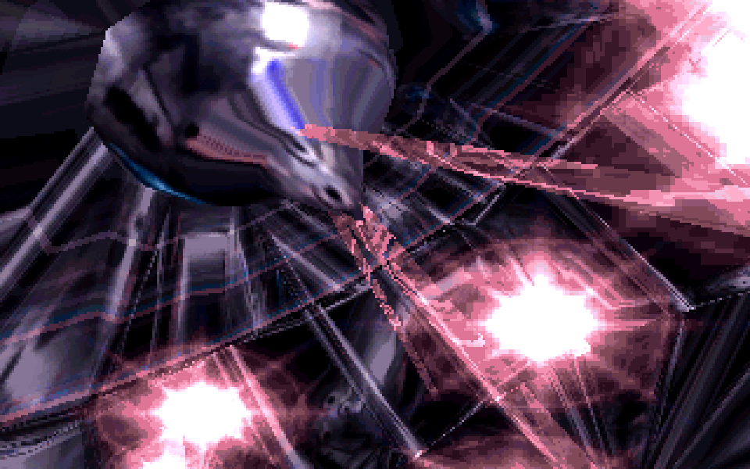
ms-dos demoscene :: the golden age:: 1996
... sqeezing last bits from freedirs and lens flares …
Toasted by Cubic Team & $een (1996)
Contrast by Oxygene (1996)
Inside by CNCD (1996)

Slide 12
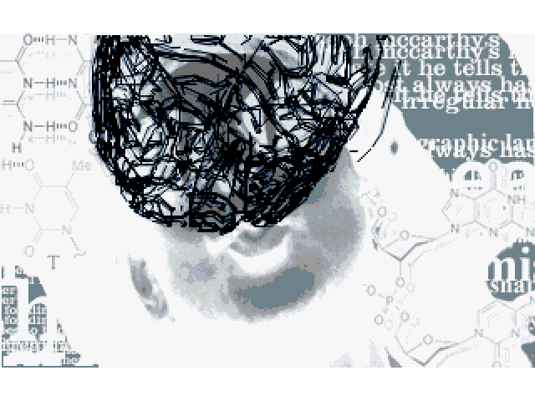
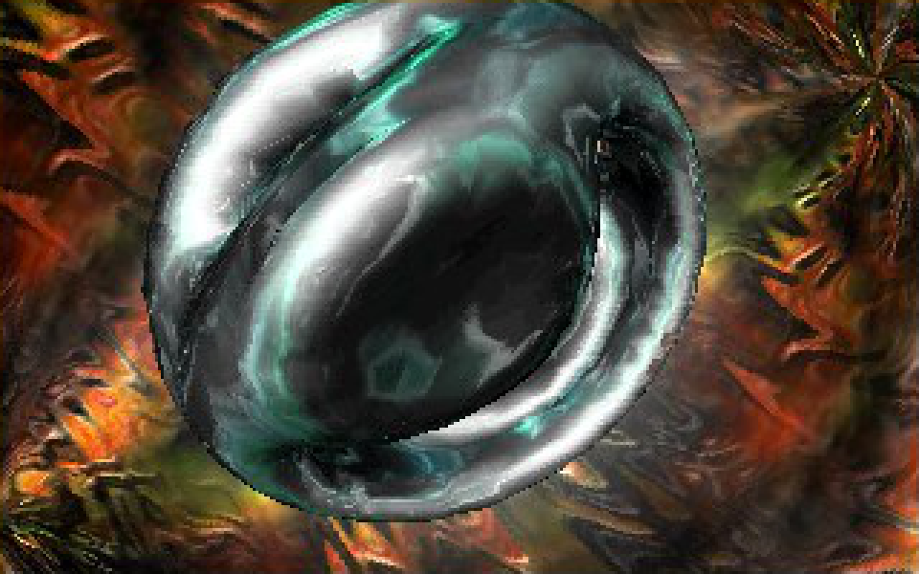
ms-dos demoscene :: the transfiguration :: 1997
... getting backed by Pentium and High Color …
Boost by Doomsday (1997)
Stash by The Black Lotus (1997)
Square by Pulse (1997)

Slide 13
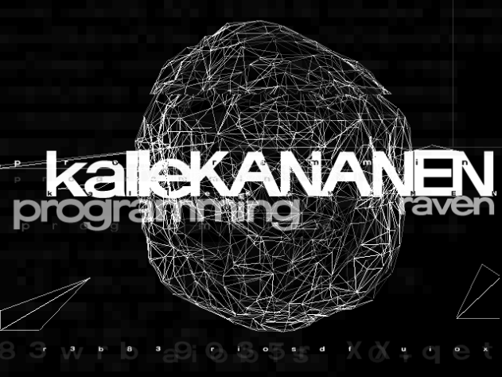
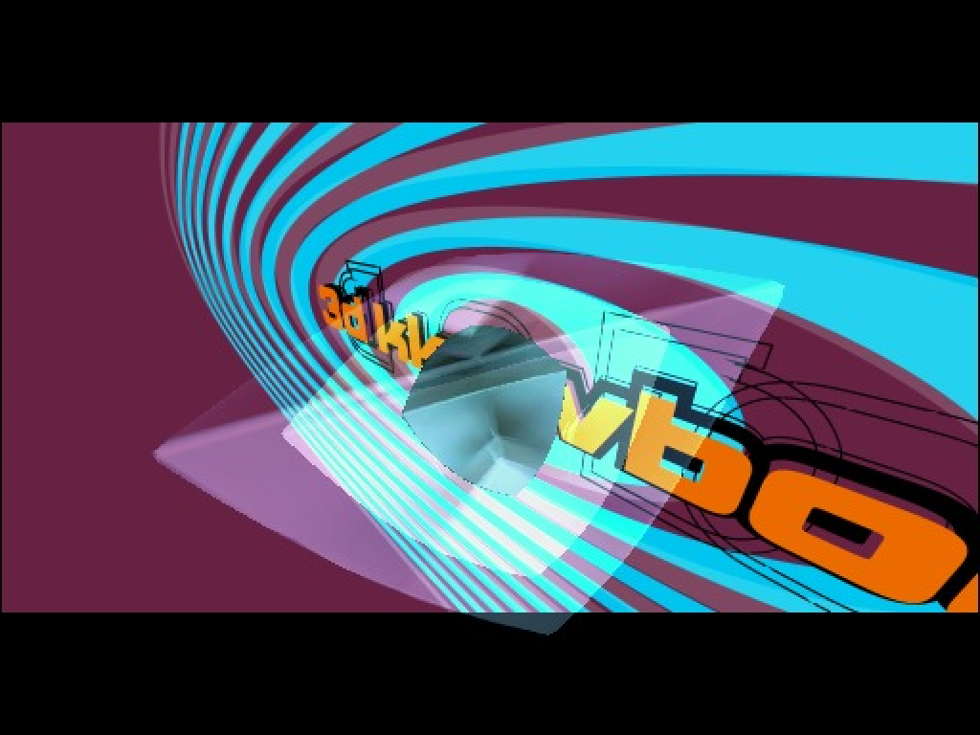
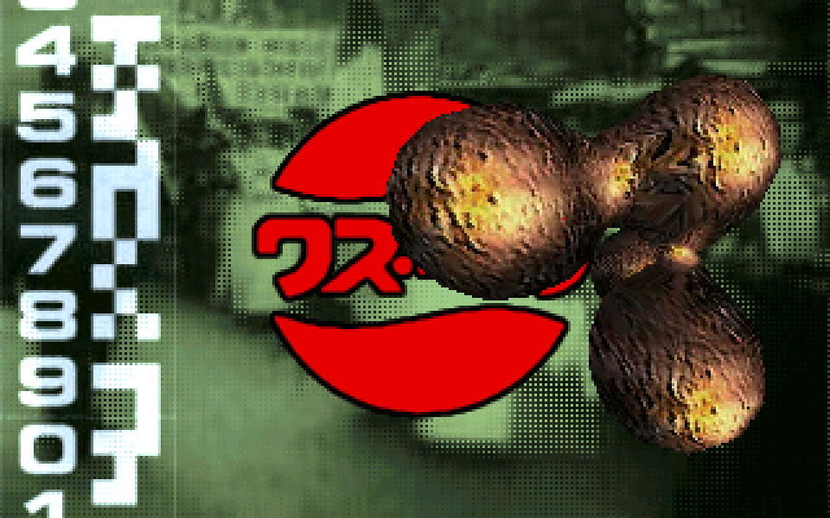
ms-dos demoscene :: the transfiguration :: 1998
... moving towards paying more attention design in lieu of code …
State of Mind by Bomb (1998)
te-2rb by TPOLM (1998)
Kkowboy by Blasphemy & Purple (1998)

Slide 14
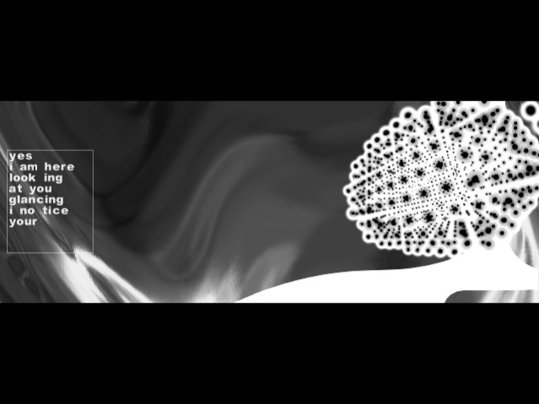
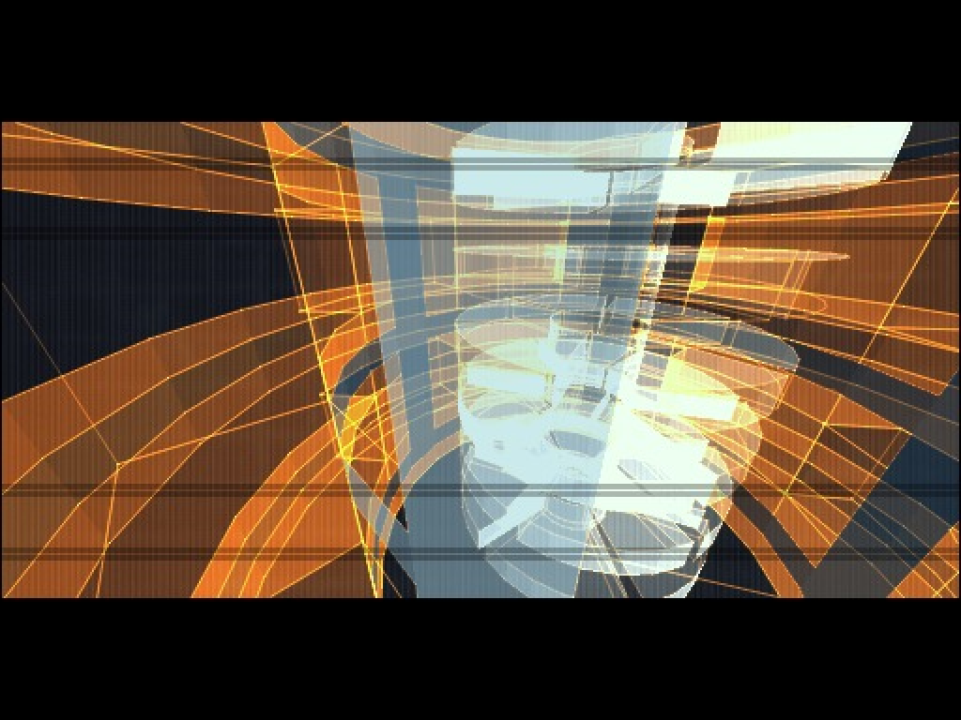
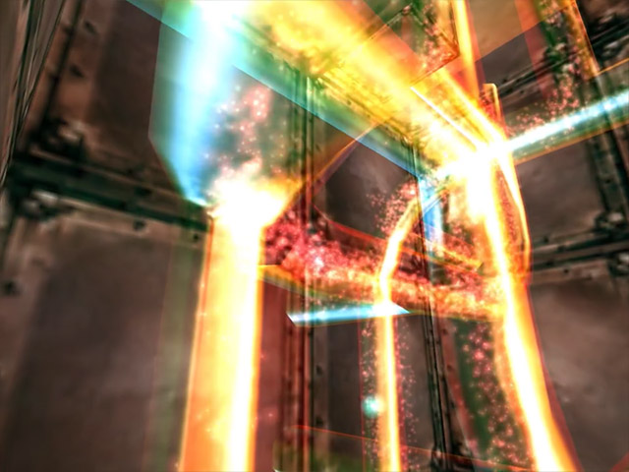
ms-dos demoscene :: the transfiguration :: 1999
... and finally heading towards world of Windows …
bakkslide 7 by Hellcore & Omnicolour (1999)
moralhardcandy by Blasphemy (1999)
Discloned by Haujobb (1999)

Slide 15
ms-dos demoscene :: current state
during 1999-2000, the PC scene almost entirely moved on Windows, exploring new 3D accelerated horizons, running towards more polygons and shaders….
but in recent 10 years with a strong retroscene movement pushing from above, the DOS scene starts to resurrect (or kinda?...)

Slide 16
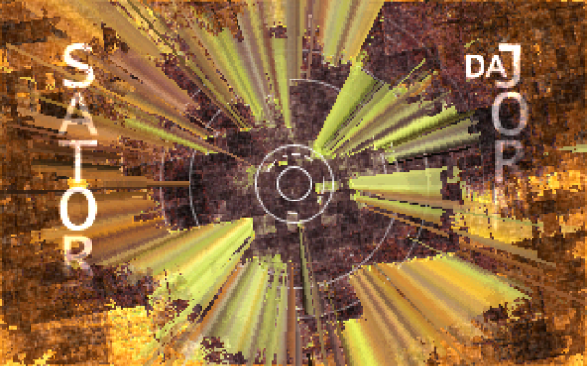
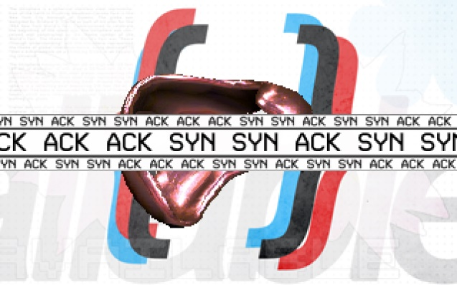
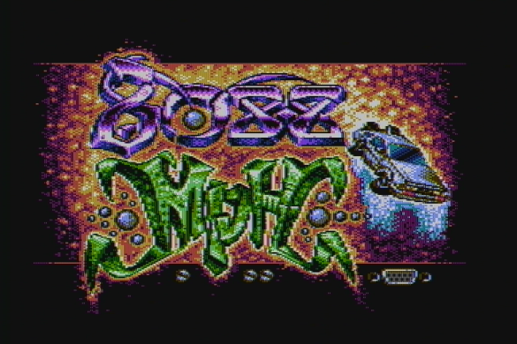
ms-dos demoscene :: current state
reserching platfoms known for so many years…
Rave On by Satori & da Jormas (2018)
cöncept by Ümlaüt Design (2021)
8088 MPH by Hornet & CRTC & Desire (2015)
...and squeezing last bits from ancient PCs

Slide 17
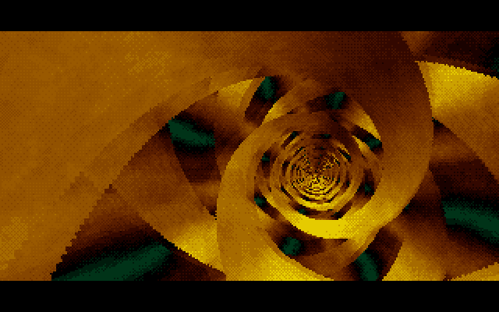

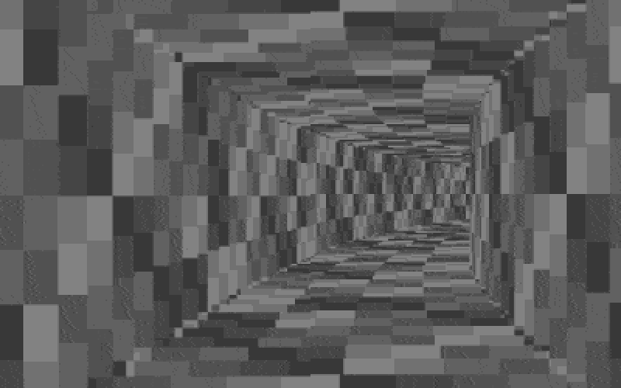

ms-dos demoscene :: current state
… as well as packing visuals to as less bytes as you can
tube by 3SC (256b, 2001)
Gyroid by Řrřola (128b, 2021)
Memories by Desire
(256b, 2020)
Blake 32 by Marquee Design (32b, 2021)

Slide 18



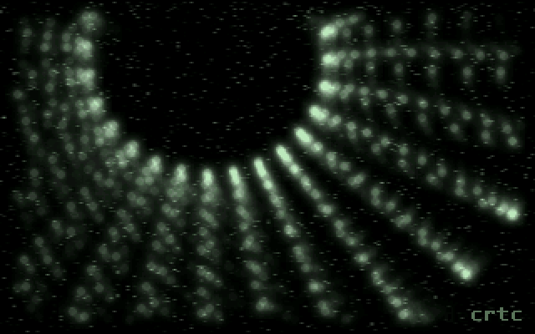
ms-dos demoscene :: my own experience
I also had quite a large scene career period associated with oldskool PC stuff (and still have :) so I’ve made a couple of demos back then…
uribin (2016) – Pentium/VESA 2nd @ multimatograf 2016
volatile (2016) – Pentium/HiColor 1st @ Chaos Constructions 2016
blash (2015) – 486/Pentium/VGA 1st @ Demosplash 2015
#vologda8df (2015) – 286/EGA (partyhack :) 2nd @ multimatograf 2015

Slide 19

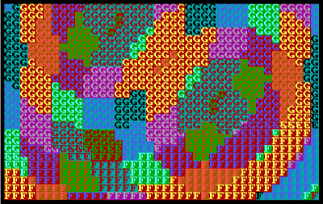
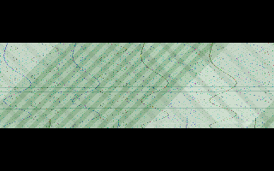
ms-dos demoscene :: my own experience
.. as well as tiny intros …
spirwd (2016) – 256b/FPU/VGA 2nd @ DiHalt 2016
pxor (2017) – 256b/8088/CGA! 7th @ Multimatograf 2017
mikrowave (2017) – HiColor
7th @ CC 2017

Slide 20

ms-dos demoscene :: my own experience
oh. by the way, all of my Watcom stuff had been open sourced :) https://github.com/wbcbz7/watcom-stuff

Slide 21
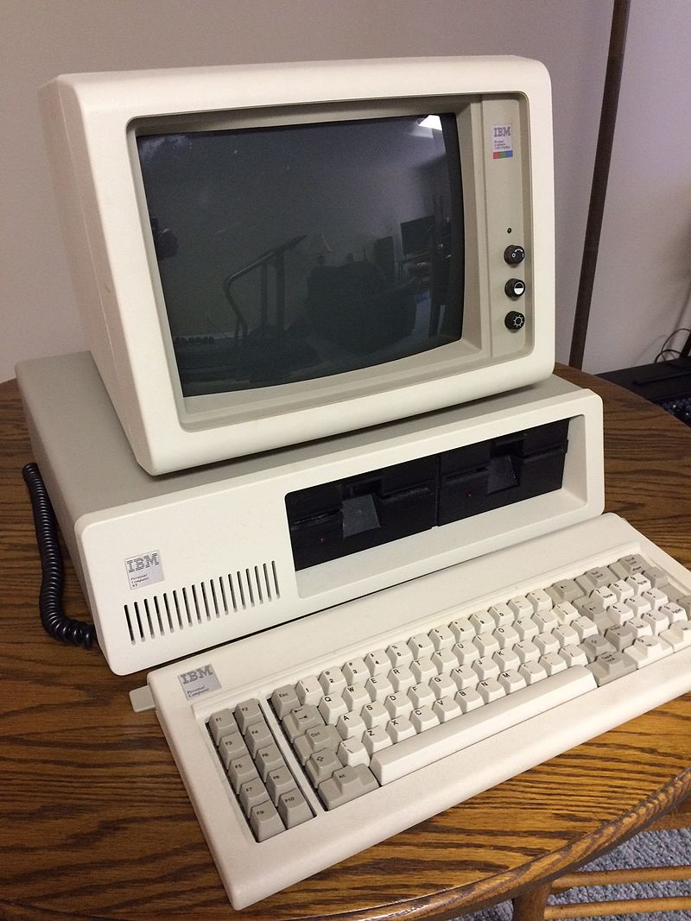
computers :: ibm pc and xt
originally IBM didn’t even intended to step on personal computer market
initial proposals were purchasing design from 3rd party like Atari, later IBM internal “Project Chess” working group developed a prototype
several CPUs were considered, notably TMS9900, MC68000 and i8086
in the end, i8088 (striped-down 8 bit bus 8086 variant) was choosen
in August 12, 1981 - IBM PC was introduced, with i8088 CPU, optional 8087 FPU, and 64 KB of RAM (expandable up to 256 KB), 5.25 inch single/double side FDDs and MDA or CGA display adapter
became a large success, sales exceeded IBM's expectations by as much as 800%, shipping 40,000 PCs a month at one point.
shipped with PC-DOS (customized IBM version of MS-DOS ), eventually made Microsoft the #1 software developer
gained instant and widespread software and hardware support
open architecture and simple design extremely encouraged new developers
Later, in 1982, PC/XT entered the market
Added internal hard disk, entended expansion capability, pumped memory capacity up to 640 KB

Slide 22
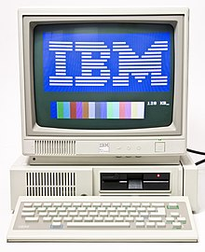
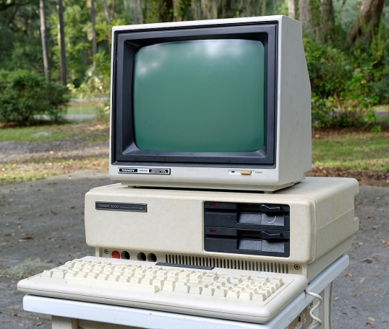
computers :: ibm pc/jr and tandy 1000
With the success of original PC, IBM tried to enter home and entertainment market with PCjr in 1984
enhanced sound and graphics capabilities
64 or 128 KB of unified (CPU and video controller shared) RAM
internal 5.25’ floppy drive and cartridge slot
ended up with numerous manufacturing and compatibility issues, becoming a failure
nevertheless, some games take advantage of PCjr capabilities
Tandy 1000 was produced by Tandy Corporation for Radio Shack shops, introduced in 1984
basically with same capabilities as PCjr, but fixed obvious flaws like allowing easier memory expansion and DOS compatibility
lower priced than most PC clones, received moderate success
later SX/LX models further fixed compatibility issues and added more features

Slide 23
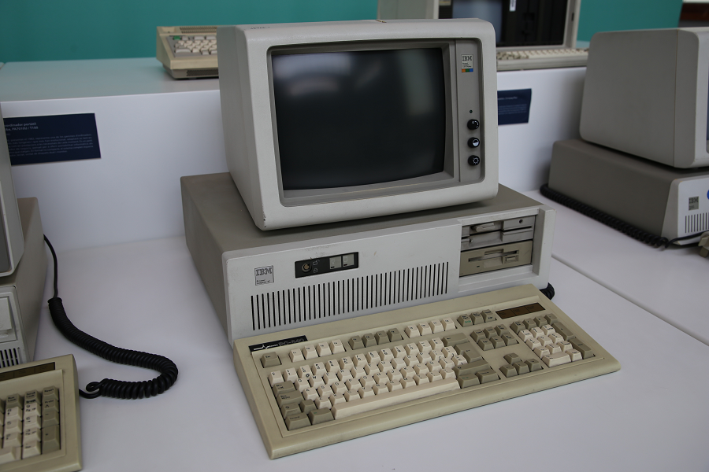
computers :: ibm pc/at
Released in 1984, marks the start of new PC era
new Intel 80286 CPU at 6 or 8 MHz
extended XT system bus to 16 bit (later known as ISA)
optionally bundled with new EGA graphics adapter
enhanced IRQ and DMA support (16 IRQs vs 8 in XT, added 3 16-bit DMA channels)
battery-backed real-time clock using MC146818 IC, with additional storage for date, time and system settings
expanded memory capacity up to 16 MB
1.2 MB 5.25 FDDs and 16-bit hard disk controller
still being functionally open design, actively cloned by many vendors
modern PCs are also retain “AT compatibility” :)

Slide 24
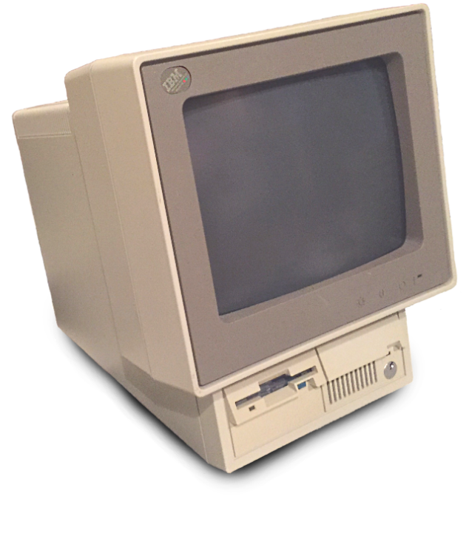
computers :: ibm ps/2
introduced in 1987
wide range of models – from 8086-based Model 20/25 to high-performance 486 and Pentium machines
software compatible with PC and AT, much like other PC clones
introduced 3.5 inch floppy drives, PS/2 keyboard and mouse interfaces, VGA display adapter and 72-pin SIMM memory modules
moved from 8/16-bit ISA bus to proprietary MCA bus, increasing performance but also locking out independent vendors
overall being more an attempt to control the entire PC market, ultimately failed
IBM then turned into niche PC vendor, with notable ThinkPad laptop series

Slide 25


computers :: meet the clones
After IBM PC success, other companies started to produce functional or full clones of original machine, often with expanded capabilities
IBM published schematics and detailed operation info in Technical Reference manuals, only BIOS remained copyrighted
several vendors made clean room implementations, notably American Megatrends, Phoenix and Award Software
1982’s Columbia Data Products MPC 1600 is the first 100% IBM PC compatible clone
first i386 PC was produced by Compaq in 1986, year before IBM PS/2
by the end of 80s, PC clones became dominant in market, and IBM eventually lost control under PC ecosystem
Intel and Microsoft became the leading force of PC evolution
MPC 1600
Compaq Deskpro 386

Slide 26



computers :: meet the clones
..and since then, everyone could built their own PCs…

Slide 27



graphics cards :: mda/hercules
MDA introduced with the first IBM PC in 1981
based on Motorola MC6845 CRTC
supports only monochrome 80x25 textmode with 9x14 charset -> 720x350 resolution at 50 Hz
included parallel port at 0x3BC
4kB of VRAM at 0xB0000
Later, Hercules released HCG with monochrome graphics mode, backwards compatible with MDA hardware/software
720x348 pixels, stored as 4-line interleaved bitmap due to 6845 limitations
64 kB of VRAM, with 2nd page at 0xB8000
cheap HGC cards were popular as both low-cost business and dual-head soultion for software debugging

Slide 28


graphics cards :: cga
along with MDA, Color Graphics Adapter was also released
also based on Motorola MC6845 CRTC, but more entertainment and home use oriented
supports 40x25 and 80x25 text modes with 8x8 matrix -> 320/640x200 resolution @ 60 Hz
80x25 mode uses entire DRAM bandwidth, “snow” artifacts apparduring screen updates while active area
supports 320x200 graphics mode with 4 colors and 640x200 mode with 2 colors
+ undocumented 160x100 16 colors mode (basically tweaked 80x25 textmode)
16kB of VRAM at 0xB8000, graphics mode layout is 2-line interlaced
drives both RGBI TTL (15 kHz) monitors and composite NTSC TVs/displays
Due to simplified composite circuitry, hires modes create artifact colors, extending available colors to 1024 and more

Slide 29




graphics cards :: cga :: magic trickery
by default, CGA support
two palettes in 320x200 mode + selectable 0th color + two intensity levels
“monochrome” mode 5 actually activates 3rd palette on TTL monitor
selectable foreground color in 640x200 mode
while it sounds pale enough, complex visuals can be delivered with clever artist work

Slide 30


graphics cards :: cga :: magic trickery
but as composite output lacks proper filtering, artifact colors are possible
setting high-resoluition mode and using alternating patters allows to create artifact colors
already often used in commercial games, like King’s Quest
abused to the limit and beyond in 8088MPH, giving 1024 simultaneous colors on screen!
check great article by VileR (if you still didn’t) for more details!
(screenshots from aforementioned write-up)

Slide 31


graphics cards :: pcjr/tandy 1000
PCjr and Tandy 1000 both use similar graphics adapter, known as “Video Gate Array”
like MDA/CGA, also based on Motorola MC6845 CRTC
unified memory architecture – VRAM is shared with system RAM, MC6845 is responsible for DRAM refresh
all 16 colors can be redefined through the palette to any of 16 RBGI colors
three additional modes:
160x200 16 colors, using 16 kB and 2-line interlaced, like CGA modes
320x200 16 colors and 640x200 4 colors, 32 kB, 4-line interlaced (unavailable in 64kb models)
composite and TTL RGBI output

Slide 32


graphics cards :: mda/cga/pcjr :: mc6845
Motorola MC6845 is one of most popular CRT controllers for personal and home computers
originally intended for character based displays
with additional circuity, graphics can be displayed
used in several popular 8-bit home computers
BBC Micro and Amstrad CPC are notable examples
had only 14 bit address support – constrained to 16 kB of VRAM for graphics mode without remapping
maximum 7 bit vertical counter – limited to 128 rows without special tricks
remapping character row address to high bits of memory address increases vertical graphics resolution
that also explains “interlaced” framebuffer structure
manufactured by several vendors (Hitachi, UMC, Amstrad), implementations differ in edge cases
known as CRTC types in CPC scene
i.e. MC8645 is used in old CGA revisions and HD6845 in new

Slide 33


graphics cards :: ega
introduced in 1984 along with IBM PC/AT line
based on custom chip design
four bitplane memory, 64 kB total in first model, later expanded up to 256 kB
dual-sync design, 16 colors out of 16/64 color palette
8x8 character textmode and 320/640x200 16 colors from 16 on older CGA/RGBI monitors
8x14 char textmode and 640x350 16 from 64 colors for EGA displays, plus 80x43 enhanced textmode with 8x8 character size
monochrome 640x350 graphics/text for MDA/Hercules dispalys
complex read/write logic and data latches offloading CPU and permitting fast VRAM copies
programmable character set
VBLANK interrupt (rarely used, deprecated in VGA)
smooth scrolling, page flipping and split screen support
feature connector for interfacing with additional h/w
BIOS and memory layout-compatible with CGA
Original IBM EGA
ATi EGA Wonder

Slide 34



graphics cards :: ega :: art
due to required compatibility with older CGA monitors, 200-line graphics modes are limited to 16 colors
that’s why most EGA games often look comparable with PCjr/Tandy in terms of colors
but thankfully to powerful EGA write logic and scroll capabilities, EGA games tend to feel more smoothly compared to PCjr titles
Commander Keen being notable example, showcasing novel Carmack’s Adaptive Tile Refresh technique
bitplane graphics also favored fast flat-shaded 3D

Slide 35


graphics cards :: ega :: art
as EGA monitors became widespreading, high resolution (640x350) games start to appear, making full advantage of enhanced RGB222 palette
most ex-USSR EGA software are HiRes, as imported machines were equpped with EGA monitors
strategic games also prefer EGA HiRes, like SimCity

Slide 36



graphics cards :: ega :: demoscene
and moreover, there are plenty of demoscene releases for the EGA!
The MEGA-EGA Demo by S-Cubed
(1994)
1991 Donut by Desire (2013)
Gr8 by Future Crew (1990)

Slide 37


graphics cards :: vga
introduced in 1987 in IBM PS/2 machines, later released as standalone (rare) ISA card
single-chip ASIC design, versatile and widely cloned :)
moved from digital to analog RGB, doubled scan rate to 31 kHz and vertical refresh to 70 Hz
RAMDAC allowing up to 256 color from 262144 3x6-bit palette
new graphics modes:
8x16 character 40x25 and 80x25 text modes
double-scanned CGA/EGA compatible 320x200/640x200modes with enhanced palette capabilities (16 sets of 16 colors from 256K palette)
640x480 2/16 colors 60 Hz high resolution and 1:1 pixel aspect mode
320x200 256 color linear (chain-4) graphics mode + various Mode-X unchained 256 modes
256 kB of VRAM, 4 bitplane arranged
register and memory layout compatible with EGA
became an instant hit, copied and enhanced countless tiles, supported by almost every OS since 90s, still supported by modern graphics cards
more in-depth VGA breakdown in “in depth” section
VGA integrated in IBM PS/2
Standalone IBM VGA card

Slide 38



graphics cards :: vga :: super vga
original IBM VGA is pretty slow due to 8-bit CPU bus, and limited to low-res 256-color modes
several manufacturers copied VGA design, enhanced it with 16-bit host bus, FIFO buffers for optimizing VRAM access, faster and larger memory, higher resolution and color modes….
commonly known as “Super VGA” cards
released from firms like Cirrus Logic, ATi, Tseng, Trident, Realtek…. varying in VGA compatibility but being totally incompatible between vendor SVGA modes
VESA standartized SVGA features with the release of BIOS Extensions (1989 and onward)
Tseng ET4000AX (1989) – best performance at the time, SVGA landmark for several years
Cirrus Logic GD5420 (1992-1994) – solid low-cost Super VGA adapter, integrating VGA, RAMDAC and PLL in one IC
Trident TVGA9000C (1992) – low-cost range adapter with abysmal planar/Mode-X performance

Slide 39



graphics cards :: vga :: super vga
… later being extended by 2D acceleration features, moving from 16-bit ISA to 32-bit VESA Local Bus….
S3 805 (1992) – mid-range SVGA 2D accelerator
Cirrus Logic GD5429 (1992-1994) – common mid-range 2D accelerator and solid VGA chipset
Trident TGUI9400CXi (1993) – low-cost 2D accelerator (and still DOOM decelerator :)

Slide 40



graphics cards :: vga :: super vga
… transitionsing by mid-90s to PCI ...
Matrox Millennium (1995) – best 2D acceleration and image quality, moderate VGA compatibility
Tseng ET6000 (1996) – fast VGA performance, not so good VGA compatibility
S3 Trio64 (1994) – all-in-one chip, low-cost bestseller and perfect VGA compatibility

Slide 41



graphics cards :: vga :: super vga
… approaching 3D acceleration and moving even further...
3dfx Voodoo (1996) – standalone 3D-only accelerator, marking the era of fast and smooth 3D on the PC
NVIDIA RIVA 128 (1997-1998) – pioneering 3D, great and compatible VGA core
S3 ViRGE (1995) – miserable 3D, nice 2D and perfect VGA compatibility

Slide 42

sound devices :: pc speaker
the most distinctive and ubiquitous PC sound device :)
supported all the way from first IBM PC to recent machines, and literally by every PC OS
originally used for system diagnostics and simple beeps, later being “enhanced” to digitized PWM samples and multichannel music
from hardware side, it’s basically:
1-bit output from PIT Channel 2…
ANDed with port 0x61 bit 0 (+ PIT gate @ bit 1)
but let alone PWM, the square wavy nature of sounds and one channel is more than enough!
(check System Beeps musicdisk and 8088MPH, also Monotone tracker
PC Speaker on original IBM PC 5150 (image by PixelatedArcade)

Slide 43

sound devices :: pcjr/tandy 1000
PCjr and Tandy 1000 machine were equipped with SN76489 programmable sound generator IC
three square wave channels
one noise channel, with 3 predefined frequencies + chained from secon channel
16 volume levels
used also in BBC Micro, TI-99/4A and SEGA Master System
PCjr and Tandy 1000 games take advantage of enhanced sound capabilities, but since demoscene on those machines is still a rare thing, not much

Slide 44

sound devices :: covox
a totally simple and cheap DIY 8-bit DAC for parallel port
originally introduced in 1987 as Covox Speech Thing, become widespread as DIY device
provides full 8-bit sample resolution, (depends on DAC accuracy but still generally better than PC Speaker)
enhanced versions (stereo on one/two LPT ports, DAC ICs, filters and amplifiers, ADC capability, ISA cards, etc)
adapted and further enhanced for almost every 8/16-bit platform (Amstrad CPC, ZX Spectrum, MSX, etc)
enhanced variant known as Disney Sound Source added 16-byte FIFO and built-in loudspeaker, partially compatible with original Covox but has own diffirences

Slide 45


sound devices :: covox :: build it yourself!

Slide 46


sound devices :: opl2/3
Yamaha YM3812 OPL2 FM synthesizer, introduced to PC with Adlib Music Synthesizer card in 1987
9 two-operator FM channels + percussion mode
4 waveforms, mono out
no PCM output capability, although it’s possible to get logarithmic 6bit DAC via FM operator tricks
easy to program, requires long delays between register writes (doesn’t matter much for XT, but becomes cumbersome on 286 and faster)
supported by most ISA soundcards (popularized by original Sound Blaster, two OPL2 in SB Pro)
supported by majority of DOS games, frequently used in BBS intros and cracktros

Slide 47


sound devices :: opl2/3
later YMF282 (used in SB Pro 2/16 and Adlib Gold) is backwards software compatible with OPL2
18 2-OP or 6 2-OP + 6 4-OP FM channels, stereo capability, 4 new waveforms
reduced access delays
many later ISA sound chips implement custom OPL3 compatible cores (Creative CQM, ESFM, etc.), with varying sound faithfulness to the original OPL3
most OPL trackers supports OPL2 feature level (HSC, RAD, AMusic, Scream Tracker 3), others like Adlib Tracker support OPL3 features
Adlib Tracker II

Slide 48


sound devices :: sound blaster
released in 1989, introduced DMA PCM to PC market
bundles OPL2 for Adlib Compatibility + two SAA1099, “DSP” chip (relabeled Intel 8051 MCU) handles PCM playback/recording + ADPCM playback + MIDI
originally supported max. 23 kHz 8 bit mono, later SB 2.0 added auto-init DMA capability for buffered playback + hi-speed mode for 44 kHz audio
relatively easy to program, supports DMA/IRQ for CPU offloading
quickly become a market success, supported by many DOS games, demos are quite different story though
Original SB 1.0 (CT1320)
SB 2.0 (CT1350)

Slide 49


sound devices :: sound blaster pro/16
SB Pro finally added stereo PCM + OPL playback
max 22 kHz 8 bit stereo or 44 kHz 8 bit mono
de-facto standard across ISA soundcards, often enhanced with own extensions (ESS cards)
later SB Pro 2.0 uses single OPL3 instead of two OPL2
SB 16 introduced 16-bit CD-quality PCM + MPU-401 compatible MIDI interface
44 kHz 16 bit stereo, backwards compatible with SB 2.0 but not SB Pro’s stereo mode
games rarely take advantage of 16-bit capabilities, but many trackers/demos/players support SB16 for better sound quality (still can’t beat the GUS :)
SB Pro 2.0 CT1600
SB 16 CT2940

Slide 50


sound devices :: gravis ultrasound
the DOS demoscene golden standard :)
released in 1992, used GF1 chip + onboard RAM for wavetable synthesis and sample playback
32 wavetable channels with linear interpolation, volume, pitch and panning control, up to 44 kHz 16 bit hardware mixing (full 32ch is 19 kHz though)
up to 1 MB of onboard RAM, 8/16bit samples
No Adlib/SB compatibility, PCM streaming has to be done by free wavetable channel + DMA
very easy to program – ideal for tracked music
almost all post-1993 demos support GUS (often as sole sound device), as well as trackers and players
Classic GUS with 1 MB RAM
GUS Ace

Slide 51


sound devices :: gravis ultrasound :: max/pnp
GUS MAX bundled CS4231A codec for streamed PCM capability and better SB emulation
in 1995, AMD develops Interwave IC, used in GUS PnP and several 3rd party cards
full 32 channels at 44 kHz + MPU-401 MIDI
up to 16 MB of sample RAM (upgradeable with 30-pin SIMMs) + 1 MB ROM
backwards compatible with GF1
some demos/players support Interwave natively, other will work fine in classic GUS mode
GUS MAX
GUS PnP with 2.5 MB

Slide 52


sound devices :: sound blaster awe32/64
basically SB16 + EMU8000 wavetable synthesizer
32 wavetable channels with 4-point interpolation, volume, pitch and panning control, up to 44 kHz 16 bit mixing + resonant filters + effect processing
16-bit only always-looped samples, up to 28 MB RAM + 1 MB ROM
Creative originally didn’t disclosed register details, several people reverse engineered EMU8000 internals then finally official hardware reference has been released
needs complex init compared with GUS, wavetable limitations (max 176 kHz pitch, 16 bit samples, etc.)
not as common as GUS, supported by some trackers (e.g. IT2) and demos
SB AWE32 (CT3990)
SB AWE64 Value (CT4380)

Slide 53


sound devices :: midi
originally used for music equipment control
1984 – Roland MPU-401 – universal MIDI interface, supports many platforms, incl. PC, support UART and intelligent accelerated mode
1987 – Roland MT32/LAPC-1 – reference music synth for early DOS games
1991 – General MIDI – standardizes instrument definitions and controls, Roland General Sound expands instrument set further
incredibly easy to program, popular in sizecoding
late-90s ISA soundcards usually implements MPU-401 in UART mode, some (GUS/AWE32) able to emulate through wavetable engine
Roland LAPC-1

Slide 54


storage :: cassette interface
yes, you heard it right – original IBM PC did included tape interface!
supported by BASIC and system BIOS, not that much useful
…you can even boot MS-DOS from vinyl :)
… or load apps via tape interface using 5150CAXX
PCjr also had similar cassette interface (with different connector), but practically never used
Several soviet IBM PC clones (i.e. Poisk-1) support cassette interface and ported some software on the tape

Slide 55

storage :: floppy disk drive
available in original IBM PC, upgraded in AT and PS/2
initially 5.25” single/double sided 40 track drives (180/360 kB)
Later IBM PC/AT introduced 1.2 MB 80-track drive
IBM PS/2 switched to 3.5 inch 720 kB/1.44 MB disks
720 kB disks were uncommon, supported with 3rd party drivers like 800.com or PU_1700 (also enabling non-standard formats up to 1.76 MB)
based on NEC uPD765 / Intel i8272 floppy disk controller and modified Shugart floply interface
max. two drives per ribbon, both drives are configured as drive B (cable is twisted between drives accordingly), Disk Changed signal in place of Ready
supports DMA read/write, offloading CPU
FAT12 is used as primary file system
early games often distributed as PC booter, allowing to boot directly from floppy, eliminating the need for booting MS-DOS

Slide 56


storage :: hard disk drive :: st-412/506
Originally added in IBM PC/XT, uses Seagate ST-412/506 hard disk and their interface
provides own BIOS extending Int13 services
most 8-bit ST-412/506 controllers are incompatible between each other, requiring disk low level formatting
IBM PC/AT used new 16-bit ST-402/506 controller by Western Digital
hard drive support included in system BIOS
initially only several predefined types of hard drive supported, later clone BIOSes (AMI, Phoenix, Award) extended by supporting user defined types and even autodetecting
generally, 16-bit ST-412/506 controllers are compatible
Later disk controller electronics moved on hard drive, providing basis for ATA/IDE interface

Slide 57


storage :: hard disk drive :: ata/ide
Introduced in late 80s by Western Digital, based on standard PC/AT hard disk controller
Universal 40-pin interface, basically 16-bit ISA extended with address decoding schematic
Replaced ST-412/506 in early 90s, providing low cost and easily expandable storage solution, eventually made its way as industrial standard and adopted by other platforms (Amiga, Atari ST/Falcon, etc.)
Supported CHS addressing, LBA added in later versions
Initially HDD-only, later adopted CD-ROM and other media types via ATAPI protocol
In mid-90s, Western Digital and Phoenix Technologies further updated the interface (Enhanced IDE), adding DMA modes, increasing capacity and standardizing geometry translation
Later UltraATA specifications added CRC control and speeded up interface to 33-133 MB/sec
Replaced during 2000s by Serial ATA, which still provides compatibility layer with IDE interface (both in software and via SATA-IDE converters)

Slide 58


storage :: today
Floppy interfaces are easy to use
USB-FDD work fine with 1.44 MB floppies, some can read and write 720k disks
3.5 inch drives are dirt cheap, modern pc (from 2010) don’t support internal floppy drives, though
5.25 are harder to find, otherwise same considerations as for 3.5 inch apply altetnatively, you can use FDD emulators like Gotek (preferably flashed with custom firmware like HxC or FlashFloppy)

Slide 59


storage :: today
Interfacing with hard disks is also relatively easy
For PC/XT, XT-IDE controller provides full IDE interface, supporting up to 2 or 4 drives
For AT and better class machines, all you need is cheap I/O multi controller (preferably buffered)
Late 486 and newer machines are equipped with built-in IDE controllers
Alternatively, discrete PCI-SATA or ISA/PCI-SCSI controllers can be used with corresponding drives
Instead of noisy old HDD, you can opt for SD-IDE, CF-IDE converter or even IDE-SATA with SSD (like I did on my P3 class machine :)
ATAPI emulators available, emulating CD/DVD drives from SD or USB flash
unfortunately they are either in development or quite costly
USB-DVD + bunch of CD-RWs + real IDE CD/DVD drive is still way cheaper
USB flash drives are exotic option under DOS (drivers exist but not guaranteed to work in every case), but if you have PC with USB port and Windows 9x installed, then why not?

Slide 60
storage :: today :: limitations
unfortunately, many systems imply HDD capacity limitations
(NOTE: this applies to IDE drives and system BIOS only!)
earlier AT BIOSes (including clones like AMI up to 1993) can’t work with drives more than 528 MB due to CHS addressing overlapping limits
with EIDE drives and geometry translation, Int13 limit is raised to 8 GB
you can still boot from larger drive, make sure boot partition is located at start of drive space. Windows 9x doesn’t care about these limitations, but you may need to use disk overlays like EZ-Drive or Ontrack Disk Manager for accessing entire drive under DOS
Award BIOS versions before 1999-2000 hang while detecting hard drives over 32/64 GB, unless BIOS is patched or updated
that’s really breaking issue, you have to use 32GB limit jumper or patch/update your BIOS
almost all pre-2002 machines imply 127 GB limit, though these disks can still work with other OSes like Windows
discrete controllers with expansion ROMs has own separate limitations (XT-IDE doesn’t have capacity limits, for example, and can work with any HDD size)

Slide 61




in depth :: x86 :: cpu evoluition
Intel 8086 (1978):
greatly enhanced i8080 design, used as basis for IBM PC family
i8088 is 8-bit data bus cost-effective variant of i8086
Intel 80286 (1982):
introduced protected mode, increased performance relative to i8086
increased address space to 24 bits (up to 16 MB)
Intel 80386 (1985):
extended x86 architecture to 32 bits, added virtual memory paging
available in two versions, SX with 16 bit data bus and full-blown DX
32-bit address space, addressing up to 4 GB of memory
Intel 80486 (1978):
pipelined design, instruction timings improved up to 1 clock per simple instructions
Integrated level-1 cache (8 KB, 16 KB
integrated FPU on die (except SX versions), clock multiplier in DX2/DX4

Slide 62



in depth :: x86 :: cpu evoluition
Pentium (1993):
superscalar in-order architecture, able to execute up to two instructions per clock
completely redesigned pipelined FPU
64-bit data bus
Pentium MMX (1997) added integer SIMD instructions for accelerating multimedia and data processing tasks
Pentium Pro/II (1995/1997):
out of order superscalar architecture, highly optimised for 32-bit software
integrated level-2 cache (up to 512 )
Pentium II moved cache on CPU cartrige and added MMX instuctions
AMD K6 (1997):
out of order superscalar design, outperforming Pentium in integer performance but performing significally slower in FPU intensive tasks
K6-2 (1998) introduced 3dNow! floating point SIMD instructions

Slide 63

in depth :: x86 :: registers
7 general purpose registers,
1 stack pointer
i386 extended all general registers to 32 bit and added FS/GS registers
used for system control structures
relatively low count compared with other paltforms, like MC68000/ARM

Slide 64


in depth :: x86 :: fpu
i8087 numeric processing unit provides floating point mathematical operations accelerating
operates on single precision (32 bit), double precision (64 bit) and extended precision (80 bit) numbers, also supports conversion between integer and floating point variables
provided basis for IEEE-754 floating point standard
registers are organized as stack of 8 80-bit registers (ST0-ST7), ST0 used as destination operand, and also can be exchanged with ST1-ST7 with FXCH instruction
FPU operations pop values off the stack and push results onto it, also providing integer/floating point variables load and store
i387 added direct sin/cos operations, making FPU fully IEEE-754 compliant
starting from i486, FPU is integrated on CPU core (except 486SX)
Pentium updated FPU with new pipelined architecture and register renaming, paring FXCH with FPU operations and performing slow instructions (divide, square root) in parallel with integer operations

Slide 65


x86 :: memory layout

Slide 66

x86 :: memory model :: real mode
In real mode, memory pointer is constructed from two components: segment and memory offset
segment value defines memory start address in units of 16 byte (paragraphs)
then, 16-bit or 32-bit offset is added to resulted segment value to form memory linear adress
segments can overlap: i.e. 0x0000:0482 and 0x0040:0082 point to same memory address 0x000482
i286 and higher calculate addresses in full 24/32bit: address overflow is possible with segments > 0xF000, allowing access to 64 Kb (minus 16 bytes) above 1 MB
called High Memory Arena (HMA) in DOS world
on 8086/8088, addresses beyond 1 MB are wrapped to start of memory: some older software depend on this behavior, and IBM implemented A20 line gate to emulate such wraparound

Slide 67
x86 :: memory model :: real mode
as following, memory pointers in x86 are of two types:
near pointer (16 or 32 bit), referencing memory within current selected segment
far pointer (16 bit segment + and 16\32 bit offset) referencing memory across different segments
thus, data and code can be either located in one segment (utilizing near pointers), or split in several segments (far pointers)
16 bit real mode applications can be compiled using 6 distinctive memory models
Model | Data | Code | Definition
Tiny | near | near | CS=DS=SS, used in .com files
Small | near | near | DS=SS
Medium | near | far | DS=SS, multiple code segments
Compact | far | near | single code segment, multiple data segments
Large | far | far | multiple code and data segments
Huge | huge | far | multiple code and data segments; single array may be >64 KB

Slide 68

x86 :: memory model :: protected mode
In protected mode, segment registers do not contain offset, instead, descriptor selector is used
defined as 13-bit selector field, Global/Local Descriptor Table select bit and requested privilege field (2 least bits)
each GDT/LDT entry contain of 8 bytes descriptor with defined stasrt offset, limit, descriptor type and access rights (whether is executable, read, write, etc., privilege level, etc)
CPU checks access rights and descriptor validity while segment register usage, raising General Protection Fault in case of failure

Slide 69

x86 :: memory model :: protected mode
while segmentation still was crucial for 286 because of 16 bit offsets, 386 and 32-bit modes do not generally need it
“flat” mode involves setting CS to code segment and DS/ES/SS with data segment, noth with base 0 and limit of 4 GB, effectively bypassing segmentation and treting every logical address as linear
i386 also introduced Memory Management Unit allowing to map virtual memory to physical in units of 4 KB pages
EMM386, Windows 3.x in 386 Enhanced mode, Windows 9x/NT and Linux/FreeBSD use paging for isolating applications address space

Slide 70
x86 :: memory model :: flat real mode
apparently, 80386 and newer CPUs use same segment descriptor pipeline for both real and protected mode, differing only in address calculation
each segment register has associated descriptor cache
it’s possible to enter protected mode, set all data segments to 4 GB limit and switch back to real mode, allowing to access data over first MB while retaining compatibility with DOS/BIOS services and interrupts
requires raw or XMS environment, most PM supervisors (like EMM386/Windows) don’t allow such tricks and either reset segment limits to 64 KB upon return to RM or terminate the application
used in several early (pre-1995) demos and even some commercial games (Ultima 7/8)
expanding CS limit over 64 KB or switching to 32 bit code segment is practically useless (RM IRQs corrupt high 16 bits of EIP, and DOS/BIOS code won’t work in 32-bit real mode)
nevertheless, there is at least one demo (Project Angel by Impact Studios, 1994) using 32-bit flat real mode
With the availability of DOS extenders, 32-bit protected mode is more attractive and easier to use than flat real mode

Slide 71
in depth :: x86 :: i/o ports
Like i8080, 8088 has separate I/O and memory address
up to 65536 byte, 32768 word and 16384 dword input/output ports (16 bit address space)
originally used 10-bit address decoding, then being enhanced to 12 bit
in original architecture, ports 0x00-0xFF are reserved for motherboard devices, ports 0x100-0x3FF are designated for expansion devices
relatively slow compared with memory-mapped IO, most of todays PC devices abandoned I/O space in favor of MMIO

Slide 72
in depth :: interrupts
hardware interrupts serviced by Intel 8259A interrupt controller
up to 8 hardware interrupts, hardware interrupt mask, selectable interrupt priority
XT uses one interrupt controller (IRQ 0-7), AT added another (IRQ 8-15)
x86 CPU supports up to 256 interrupt vectors
first 32 vectors are reserved for CPU exceptions
IRQ 0-7 are mapped to INT 08-0F, IRQ 8-15 mapped to INT 70-77
conflicts with exception vectors – doesn’t matter much in real mode, needs to deal with or remap in protected mode
several software INTs used for BIOS and DOS services
protected mode enhanced interrupt capabilities
able to switch between privilege levels, providing system call facilities

Slide 73
in depth :: interrupts
INT # Function
10 video services
11 equipment resuest
12 memory size
13 disk I/O service
14 serial communications)
15 system services, cassette
16 keyboard services
17 parallel printer services
18 ROM BASIC loader
19 bootstrap loader
1A Time/Date inter
1F graphics character table
20 DOS general program termination
DOS function API
DOS multiplexer
31 DOS Protected Mode Interface
33 mouse support
67 EMS specification
IRQ# Interrupt Function
IRQ0 8 PIT timer
IRQ1 9 keyboard service required
IRQ2 A EGA/VGA vertical retrace
IRQ8 70 real time clock
IRQ9 71 software redirected to IRQ2
IRQ10 72 free
IRQ11 73 reserved (AT,XT286,PS50+)
IRQ12 74 PS/2 mouse interrupt
IRQ13 75 numeric coprocessor error
IRQ14 76 Secondary IDE controller
IRQ15 77 Primary IDE controller
IRQ3 B COM2 or COM4
IRQ4 C COM1 or COM3
IRQ5 D sound card
IRQ6 E floppy disk drive
IRQ7 F LPT1 or sound card

Slide 74
in depth :: isa dma
based on Intel 8237 DMA controller with external 74LS612 memory mapper
PC and XT have 4 8-bit DMA channels, AT added 4 16-bit channels
original i8237 is unable to work with more than 64 KB of RAM, so mapper supplies high order address bits
because of this, DMA transfers cannot cross 64 KB boundary, and work only in first MB (8-bit) or 16 MB or RAM (16-bit)
used in PC and XT for DRAM Refresh and floppy/hard disk transfers (channels 0 and 2 respectively), AT
due to slow speed and compatibility issues, used mostly by low rate devices such as sound cards, network interfaces and floppy disk controllers

Slide 75
in depth :: timing
PCs are usually employ several timing methods:
Programmable Interval Timer Channel 0 at IRQ0
running at 18.2 Hz by default, used by BIOS for disk timeouts and time counting
the primary and precise enough universal timing source
often being used by TSRs and sound systems, needs precautions for timer sharing
RTC timer at IRQ8 (AT and higher)
counts at rates from 8 up to 8192 Hz, with power-of-two frequency step
unused by BIOS routines by default, easy to interface (example in rtc_test folder)
Time Stamp Counter (Pentium and higher)
Incremented each CPU clock, available by RDTSC instruction in EDX:EAX
needs calibrating to other timing source (i.e. IRQ0) before use, provides extremely precise timing, very useful in profiling
VGA Vertical Retrace bit in Input Status Register (port 0x3DA bit 3)
unfortunately VBLANK IRQ is deprecated on VGA and unavailable, and port polling can result in retraces being mussed, causing slowdowns

Slide 76

in depth :: vga
your working horse for DOS journey :)

Slide 77
in depth :: vga :: access
Memory Address | Description
0xA0000 – 0xAFFFF | EGA/VGAs framebuffer
0xB0000 – 0xB7FFF | Monochrome framebuffer
0xB8000 – 0xBFFFF | Color text and CGA famebuffer
I/O Port Address | Description
0x3C2/0x3CC | Miscellanous Output Register
0x3D4-3D5/0x3B4-3B5 | CRT Controller Index/Data
0x3C4-3C5 | Sequencer Index/Data
0x3DA | Input Status Register
0x3CE-3CF | Graphics Controller Index/Data
0x3C0/0x3C1 | Attribute Controller Index/Data (combined)
0x3C6-3C9 | RAMDAC Registers

Slide 78
in depth :: vga
CRT Controller
generates all the necessary display timings, provides memory address for display refresh
Sequencer
generates basic display timings (dot and character clock), arbiters VRAM accesses between CPU and CRTC, protects bitplanes for being changed
Graphics Controller
interfaces between display memory and both attribute controller and CPU, converts and translates VRAM data, performs complex CPU write/read logic for speeding up access
Attribute Controller
formats input graphics and text data to pixel stream, handles blinking, underline and cursor logic
RAMDAC
converts digital pixel stream throung color lookup table to RGB triplets, then converting RGB digital data to analog
Many SVGA cards add additional functions, e.g. 2D/3D acceleration, fast FIFO interface to VRAM, etc.

Slide 79

in depth :: vga :: graphics controller
Setting individual pixels with bitplane structure is slow
Read from all 4 bitplanes, modify, write back
VGA includes special circuity for speeding up
common graphics tasks
Latches work as 4 8-bit buffers between VRAM, and graphics controller logic, loaded with VRAM data at CPU read address
Read modes include either reading one selected bitplane, or comparing latches data against reference color, allowing pattern searching and fast flood fills

Slide 80


in depth :: vga :: write modes
Write Mode 0:
CPU data rotation
Individual plane Set/Reset control for plane masking
ALU operations: move\AND\OR\XOR
Masking individual pixels by bit mask
ideal for pattern fill
Write Mode 2:
CPU data replicating “color” bitwise for all pixels in 8x1 block
ALU operations: move\AND\OR\XOR
Masking individual pixels by bit mask
suitable for plotting individual 16c pixels or Mode-X line drawing

Slide 81


in depth :: vga :: write modes
Write Mode 1:
direct latch->VRAM copy
as latches are loaded for each byte read from memory, this can be used for fast VRAM->VRAM blits
Write Mode 3:
CPU data rotation and masking with bit mask, used as bitwise “selection” between latch data and constant color
suitable for pattern or line drawing in 16 color modes

Slide 82



in depth :: vga :: 16 color modes
known from EGA days and 640x480 HiRes modes, being greatly enhanced in VGA:
16 sets of 16 colors, out of total 262144 colors
split screen and smooth scrolling
up to 8 video pages
200-lines mode double scanning improving graphics quality
bitplane structure, ideally suited for flat-shaded 3D and translucency effects
lots of VGA demos and games take advantages of 16-color modes for fast and smooth action

Slide 83

in depth :: vga :: 16 color modes

Slide 84
in depth :: vga :: 256 color mode
the most innovative addition to VGA, giving vivid colors and outperforming competing platforms
linear memory layout (one byte – one pixel), ideal for graphics applications, faster than planar approach and giving green light to fast paced 3D action FPS
wide palette range – 64 RGB levels, total 262144 colors palette
cons: chained on top of EGA planar architecture, wasting ¾ of VRAM and permitting one page only :(

Slide 85

in depth :: vga :: 256 color mode

Slide 86



vga :: 256 color mode :: mode-x
discovered by several people, popularized by Michael Abrash, the way of disabling plane chaining results in faster
entire VRAM is useable, allowing 4 pages in 320x200 mode, smooth scrolling/panning, double\triple buffering and high resolutions up to 360x480
Write Mode 1 (VRAM copy) can be used for fast sprite and image objects blitting
somewhat ankward memory layout, still pretty fast for column filling
early 3D shooters like Wolfenstein 3D (1992) and DOOM (1993) render walls as textured columns of constant depth, which is equally fast in both Chain-4 Mode 0x13 and Mode-X, while the latter having advantage of multiple page buffering

Slide 87

vga :: 256 color mode :: mode-x

Slide 88
in depth :: vga :: text mode
the good ol’ textmode got also heavily upgraded in EGA and VGA:
up to 8 user-defined character fonts, 1 or 2 on screen
blink, underline and hardware cursor effects
smooth text scrolling and panning
high character resolution – 9x16 font, 1-32 lines
enhanced capabilities were hugely praised by ASCII/ANSI scene

Slide 89

in depth :: vga :: text mode

Slide 90


in depth :: vga :: color pipeline

Slide 91


in depth :: vga :: color pipeline :: colors
attribute controller palette colors
with Color Page registers, either 4 sets out of 64 colors or 16 sets out of 16 can be selected with one register write
RAMDAC palette colors
total 3x256 colors = 768 bytes, Red first then Green and Blue; palette index is autoincremented for batch color updates

Slide 92

in depth :: vga :: split screen
ability to scroll playfield independently of bottom bar
static graphics is placed at offset 0
CRTC Line Compare register sets to number of split line
when split line is reached, display address counter resets to 0

Slide 93

in depth :: vga :: scrolling
smooth scrolling\panning as combination of CRTC and attribute controller functions

Slide 94

in depth :: vga :: scrolling
smooth scrolling\panning as combination of CRTC and attribute controller functions

Slide 95
in depth :: vga :: scrolling :: precautions
unfortunately, scroll settings are distributed among 4 registers:
Horizontal Pixel Panning (attribute controller index 0x13, pixel-precision H scroll)
Preset Row Scan (CRTC index 0x8, pixel-precision textmode V scroll)
Start Address (CRTC index 0xC/0xD) – start position in pixels or characters
moreover, CRTC and ATC registers are latched once and cannot be changed mid-frame
CRTC registers are latched at leading edge of VSYNC pulse (port 0x3DA bit 3 0->1 transition)
Horizontal Pixel Panning latched at start of display enable (port 0x3DA bit 0 1->0 transition)
and to make everything complicated further, some SVGAs (ATi, Matrox) latch scroll registers at different positions than most of VGA cards (check marvellous Gona’s compatibility chart)
solution: update CRTC registers during active display, update ATC registers on VSYNC (port 0x3DA bit 3 0->1 transition)
side advantage: pseudo-triple buffering

Slide 96
in depth :: vga :: black magic
even if changing start address midscreen is not possible, there are still lots of usable tricks
polling for display enable (port 0x3DA bit 0) for tracking HSYNC and changing palette mid-line
COPPER BARS! AMIIIIGAAAAAAA!
Setting Offset register (CRTC index 0x13) to 0 – displays same line on every scanline
kefrens bars, Y-zooms and even crude X-wobbles
resetting split screen position multiple times per frame, changing modes mid-frame
oddball graphics modes: 16 color linear, 256 color semi-planar, CGA chain-4, etc.
simulating true color modes on standard VGA with color interlacing
…and much much more :)
SVGATRIX by Type One/TFL-TDV serves well as reference

Slide 97

in depth :: vga :: black magic
Kukoo 2 by TFL-TDV (1994) – breaking every rule in the book

Slide 98


in depth :: vga :: aspect ratio and refresh rate
common VGA modes (except for 640x480) are 16:10 and runs at 70hz vertical
while being displayed on 4:3 monitor, graphics is being distorted
70 Hz refresh considered as advantage during CRT era, but nowadays causes troubles with modern frame grabbers and displays
with CRTC tweaking, 320x200 letterboxed 60hz modes can be achieved

Slide 99
in depth :: vga :: bios
VGA adapters typically contain ROM with BIOS firmware, providing video services via Int 0x10
mode set with AH= 0
pixel set/get (slow, but often used in sizecoding)
palette loading functions (AH = 0x10)
text output (notable functions are TTY output (AH=0E) and string write (AH=0x13))
font manipulations (AH = 0x11): charset uploading, font pointer retireving
graphics page, text scrolling and cursor control
…and some more
some aspects of VGA programming are easier to interact via BIOS than direct programming, and vice versa
i.e. palette updates are done faster with direct IO port access

Slide 100
in depth :: vesa bios extensions
by the early 90s, VGA limitations became obvious, and Super VGA adapters were not quite compatible from software side
i.e. 640x480 256 colors uses 300 kB of VRAM, requiring bank switching or linear frame buffer
every vendor used its own hardware method to select banks, and bank size/granularity differ from each other
moreover, even SVGA mode numbers were different between vendors!
High/True Color modes (16/24/32 bits per pixel) are starting to gain attention, first appearing on professional accelerators, then making its way on mass market
while it wasn’t such an issue for Windows applications or popular software packages like AutoCAD, because they implemented own driver model, independent from VGA BIOS API, DOS applications have to reimplement support for each VGA chip
as result, in 1989 Video Electronics Standard Association (VESA) developed a unified API for accessing SVGA features from bios and DOS applications, called VESA BIOS Extenstions (VBE)

Slide 101
in depth :: vesa bios extensions
key features:
extending VGA BIOS Int10 calls with new API (AH = 0x4F)
standard interface for graphics adapter information retrieving and display mode enumeration
mode numbers are extended to 15 bit (+ VRAM clear request bit), with common modes being pre-assigned
unified interface for bank switching, either via Int10 or direct procedure far call
support for smooth scrolling, virtual screens and page flipping
starting from VBE 2.0 (1994), Linear Frame Buffer support added, eliminating the need of bank switching for 32-bit protected mode applications
also, protected mode VBE interface was inplemented, although not much used in software
VBE 3.0 (1998) added refresh rate control and stereoscopic display support
unfortunately, not every graphics chip vendor did implemented VBE correctly, causing incompatibility issues (missing LFB support, no lowres modes, scrolling issues, etc.)
SciTech Display Doctor (aka UniVBE) is alternative VBE driver for numerous SVGA cards, implementing full VBE specifications with additional features

Slide 102



in depth :: vesa bios extensions :: in demos
lots of late 90s demos use either one of these mode
640x480 256 colors, sometimes 16/32 bpp also
low resolution Hi/True Color modes, like 320x240 16/32 bpp
exotic 15 and 24 bpp modes are not uncommon
same with oddball resolutions like 400x300 and 512x384 (half of 800x600 and 1024x768, respectively)
some productions don’t respect screen pitch(aka logical width)
resulting in squashed or skewed picture on some SVGAs

Slide 103

in depth :: dos
single-tasking operating system
applications can hook interrupt vectors, then terminate with staying resident in memory, providing basic multitasking and system enhancing capabilities
16 bit real mode only, applications have to us special software APIs for extending capablilities
evolved during years, notable versions:
MS-DOS 3.30 (1987) – well suitable for XT
MS-DOS 5.0 – 6.22 (1991-1994) – used during 386/486 era

Slide 104
in depth :: dos :: memory interfaces
eXtended Memory Specification (XMS):
allows to allocate, free and transfer data between extended and
applications can hook interrupt vectors, then terminate with staying resident in memory, providing basic multitasking and system enhancing capabilities
Expnaded Memory Interface (EMS)
access to extended memory via page aperture switching

Slide 105

development :: getting started

Slide 106
development :: old toolchains
QuickBASIC?
slow, and doesn’t have any decent sound capabilities without calling external code libraries
besides, there are plenty of decent QBASIC demos (hey, DC5!)
Borland Pascal?
you’re probably loved (or hated) it back in the days
plenty of code examples and sound systems, all in one IDE
poor code optimization, no 386 target support -> DB $66 HELL
ending up making 90% of demo in assembly *shrug*
Turbo Assembler?
while it is actually pretty decent choice…
however coding in 32-bit protected mode is tricky (fortunately PMODE can save you from cracking your head)
there are enough new and easier to use assemblers
… as time flies, we can choose better tools…

Slide 107



development :: open watcom c\c++ ::
the flagship DOS development tool, popularized by DOOM (1993) and used by almost every major DOS title since
friendly 32-bit DOS environment – zero-based memory model (with 1st MB mapped 1:1 – no need to fiddle with segments), extended Int21 interfaces, comprehensive DPMI support, up to full 4GB
cross-platform – targets 16-bit and 32-bit DOS, Win16, Win32, Linux, OS/2, Netware, upcoming x86-64 support; can cross-build DOS apps under Windows/Linux
supported by lots of video/sound libraries
decent code optimization – not the best by today’s standards but still doesn’t struggle like SDCC on Z80 :)
language features support still near C++98/C99 levels (no C++11 sweetness, sorry)
active development ceased after 1997, has been open-sourced in 2002 then being maintained by enthusiasts

Slide 108


development :: djgpp
a port of GCC toolchain for 32-bit DOS environment
updates frequently (last build in 2020 featuring GCC 10.2)
used by less software, Quake (1996) being the notable example
Easy cross-compiling on Windows/Linux host, good 3rd party IDE/code editor support
built-in GO32 DOS Extender- depends on DPMI host only
less memory-friendly than Open Watcom – non-zero based memory model – more stable but requires to change segments to access DOS memory/VGA framebuffer
great code optimization, latest C++17 features supported
scarcer library support (Allegro is pretty redundant for demos)
anyway a better (probably) than Watcom choice if you only want to blit frames and don’t go deep into hardware trickery (i.e. targeting Pentium/VGA/VESA), unsuitable for XT/286

Slide 109
development :: assemblers
Flat Assembler (FASM)
relaxed syntax compared to TASM, easy to use
targets 16/32/64 bit code, supports all instructions from 8086 to AVX2
outputs .COM/binaries, MZ/PE EXE, ELF and COFF object files
open source, active community
cross platform, runs under DOS, Windows and Linux
well suited for sizecoding
Netwide Assembler (NASM)
feature-wise comparable to FASM, has more complex and versatile macro facility
in addition to FASM output formats, supports a.out, OMF, Mach-O and more
also open source, runs on Windows, Linux, macOS, DOS and even KolibriOS
overall a slightly better choice than FASM

Slide 110
development :: ide
depends on what you want to do
for simple projects (like tiny intros), text editor like Notepad++ or Sublime Text + console is enough
complex stuff often requires some kind of building system + comprehensive IDE
Visual Studio Code is popular and versatile IDE choice
doesn’t like Watcom C++ stuff much, needs some tweaks
Since Watcom’s C++ dialect closely resembles Microsoft compilers, “msvc-x86” works pretty well
https://github.com/intbeam/watcom-vscode suits well as template
DJGPP and pure x86 asm is almost out of box
makefiles are fine, CMake is also a decent choice for crossplatform projects
supports targeting both Watcom C++ and DJGPP

Slide 111
development :: debugging
for 16-bit apps, Turbo Debugger suits pretty well, if you really love to debug on real thing
Watcom C++ package comes with own versatile debugger (wd.exe)
comes with both DOS and Windows (console and GUI wdw.exe) versions
supports remote debug via serial link, TCP/IP, named pipes or Win 9x DOS session
serial null modem is most stable and useable option
debugs both 16-bit and 32-bit DOS executables
for DJGPP, gdb is the number one choice
also supports serial link debugging
of course, you have to compile your application with debug information to see anything other than pure asm :)
DOSBox and Bochs comes with their own built-in debuggers
best suitable for debugging system-related code

Slide 112


development :: graphics/music
the choice of graphics tool depending on what type of graphics do you prefer
pixelart: aseprtie, usenti, GrafX2, Multipaint, etc.
illustrative gfx: better you know :)
batch processing/conversion: ImageMagick, Image Alchemy
regarding the music, it mostly depends on your preferred sound device:
PC Speaker: MONOTONE, PCSPE VSTi plugin, Vortex Tracker II
OPL2/3: Adlib Tracker II, several native DOS OPL trackers OpenMPT, Scream Tracker 3
modules: OpenMPT, MilkyTracker, FT2/PT2.3D Clone, native DOS trackers (ST3/FT2/IT2)
streaming ADPCM/MP2/MP3: any DAW you like :)

Slide 113
development :: sound system
as already stated, this heavily depends on what you want to play
PC Speaker: write your own routine, it’s not that hard
tip: many PC games supporting PC speaker play raw periods dump
OPL2/3: depends on target platform
most DOS OPL trackers come with player routine, although it’s almost always 16-bit real mode
for 32-bit, you can abuse game MIDI libraries like AIL or HMI, but that would be totally overkill
as alternative, convert module to OPL register dump and play with custom routine, much like PC Speaker case
streaming music (ADPCM/MP2/MP3):
unfortunately, didn’t was a thing back in the days, and comparing to Amiga/Atari Falcon scene, no suitable streaming music players are available
theoretically MIDAS 1.1.2 can play ADPCM samples, albeit I didn’t tested that yet
alternative 1: grab amp/mpg123/State of Mind (1998) demo sources, add SB output routine, done
alternative 2: cut your music into long samples, put into XM/IT, play with module player (see below)
extra tip for DJGPP users: use Allegro for playing in background (branch approves)

Slide 114
development :: sound system :: mods
tracked modules: the sweet spot of DOS scene :)
16 bit – forget about XM/IT
MIDAS 0.40a is the best you can have, plays MOD/S3M, links with ASM/C/Pascal code, supports GUS and SB (unfortunately needs EMS), open source, doesn’t work fine under Win9x
DemoVT – resident player (can be used with BASIC demos!), MOD/S3M, GUS/SB
MODOBJ and STMIK are too old, GUSPlay is simple to use but GUS-only, BWSB nags upon exit
32 bit – “are you still complain against 386? we’re going after you!”
Indoor Music System – Cubic Player’ internal engine, plays MOD/S3M/XM/IT, supports GUS/SB/AWE32 native, Windows-compatible, a bit slippy to use, Watcom only
the MXMPlay fork is compact and fits great for 64k intros, XM/GUS only, PMODE/Watcom, Windows-friendly
MIDAS 1.1.2 – the definite music system, plays MOD/S3M/XM/IT, supports GUS/SB, cross platform (Watcom/DJGPP/Win32/Linux)
JUDAS Sound System – optimized mixer, plays MOD/S3M/XM/IT, supports GUS/SB, Watcom only, doesn’t work under Windows
Useless Module Player - plays MOD/S3M/XM/IT, supports GUS/SB/PC Speaker (yes!), PMODE/EOS/Watcom, also hates Windows
RXMPlay – XM only, compact, GUS/SB/AWE32, PMODE/Watcom, Windows-friendly

Slide 115
emulators :: virtual machines
don’t use them. Not even VMware. Not even Oracle VM VirtualBox.
since VMs are focused to run newer host systems, they don’t bother to emulate common features being used by DOS high-performance stuff (cycle-accurate VGA emulation, VBE, etc)
Bochs/QEMU is relatively decent, but please refrain from using them as first-class testing environment

Slide 116

emulators :: dosbox
the easiest and most balanced way to test your DOS stuff :)
emulates DOS environment, can mount host folders as disks, floppy and CD images
vanilla DOSBox builds are games-oriented and feature-limited, doesn’t cycle-accurately emulate VGA well, had trouble with tricky stuff, seldom updates
…fortunately, as it’s open-source, better forks exist, i.e. DOSBox-X:
emulates everything from PC/XT to Pentium Pro/MMX, and even PC-98!
near perfect VGA emulation (still improving but runs 99% of demos great), great SB/GUS support, emulates SVGA (as S3 Trio64) and 3dfx Voodoo well
can boot and run Windows 3.x/95/98 (if you really want it)
works on Windows, Linux and macOS, and even able to run under real MS-DOS :)

Slide 117

emulators :: pcem
contrary to DOSBox and like other platforms emulators, emulates full PC environment
cycle-exact device emulation (the 8088+GCA configuration runs 8088 MPH almost perfectly)
emulates lots of devices (floppy and hard drives, CGA/EGA/VGA + several SVGA models, SB16/AWE32/GUS/Interwave, 3dfx Voodoo and much more)
easy to adjust configuration – from 8088/4.77MHz to Pentium MMX/II
uses real hardware ROMs (not HLE like DOSBox), you have to find them on the Internet and place in emulator ROM folder
stopped active development in 2021 :( latest version released in Dec ‘20

Slide 118
sizecoding
art of making audiovisual stuff in extremely tiny executables
(512 bytes or less )

Slide 119
sizecoding :: why dos?
usually, larger size intros (1k and more) are coded for Windows or Linux, taking advantage of advanced graphics capabilities
in case of 512b or less, the EXE header alone eats about 50-100 bytes and initialization code takes as much as same, if not more!
in contrast, DOS .COM files are just pure header-less executables, and graphics/sound initilaization takes only several dozens bytes
cons: no fancy hardware 3D, 16-bit code by default
on the other hand, accessing i.e. VRAM or playing sound is easier and smaller code-wise than under Windows
some intros even take advantage of high VBE resolutions and modern instruction sets like SSE4/AVX, and everything under DOS! :)
sound is more troublesome, though
MIDI is easies tto use, following by Covox and PC Speaker

Slide 120
sizecoding :: tricks
sizecoding.org provides lots of incredibly valuable info about tiny intro tips and tricks
linear modes like 320x200 256 colors are the easiest and fastest to work with
.COM files suits best for sizecoding, and you can even write your intro in a boot sectpr!
during .COM startup, several registers are set to known state, so you can use default values to save some bytes
enable listing output in your assembler and mark the hot spots with long opcodes your code, then prioritize them for size optimizing
use full 16-bit register for simple instructions (dec, inc, add and so on), take a look on 1-byte instructions (movs/stos/xlat/etc.)
use code as floating point constants – can really save a byte or two, if not more :)
even default VGA palette can be useful, esp. if you’re running out of free space

Slide 121
closing words :: tips & advices
learn from others, don’t hesitate to look into code sources
but at the same time, be creative! restrain from blatantly riping and copying effects, add something from yourself :)
test your production on as much machines/platforms as you can
do not lock out on specific hardware without a reason (like making a Pentium/VESA demo GUS-only)
yea, Gargaj, I’m talking about you :)
provide a decent video capture, but try to forget about real HW enjoyers :)
don’t be afraid of your first steps, create, release, learn and improve
everything is evolving iteratively

Slide 122
Q & A time :)

Slide 123
….and don’t forget to come to Combined 256b Intro Compo!...
…i made a little surprise for you, IBM PC lovers :)
…and other compos @ Demodulation as well :)

Slide 124

thanks for reading and watching!
seminar materials (with examples)
https://github.com/wbcbz7/yadm21_seminar
contacts:
wbcbz7.at(at)gmail.com
https://t.me/wbcbz7
discord: wbcbz7#3519

